Slide 1
LEE FRIEDLANDER
A PERSONAL REASSESSMENT

Slide 2
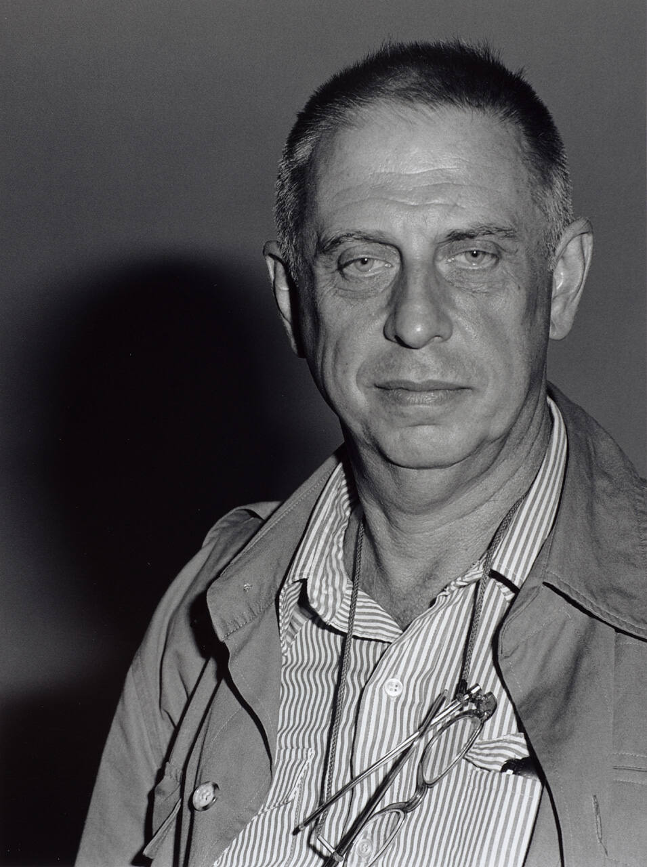
LEE FRIEDLANDER
b. July 14 1934
Aberdeen, WA
HAPPY BIRTHDAY,
LEE !!

Slide 3
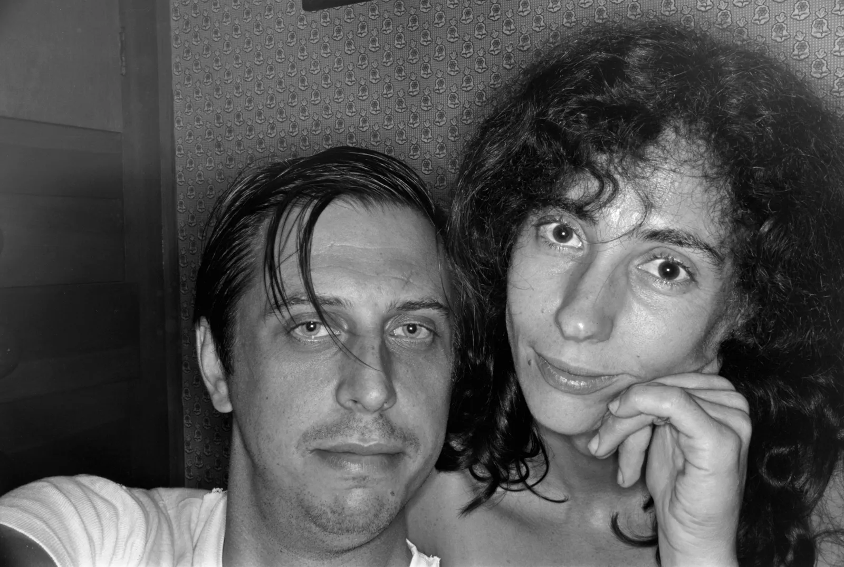
BIOGRAPHICAL LANDMARKS
Born to Kaari Nurmi and Fritz (Fred) Friedlander
Studied at Art Center College of Design – Pasadena CA
Moved to NYC in 1956. Photographed jazz musicians for record albums.
Married Maria in 1958 (subject of many portraits). Daughter Anna married to photographer Thomas Roma; son Eric is cellist and composer.
Influenced by Eugene Atget, Robert Frank, and Walker Evans. Regarded as Atget’s heir.
Awarded Guggenheim Fellowship in .in 1962 and 1977.
First solo show International Museum of Photography at George Eastman House 1963.
Key figure of New Documents show at MOMA in 1967 with Winogrand and Arbus.
1990: MacArthur Fellowship
2005: Major retrospective of 400 photographs at MOMA.
Photographed Frederick Law Olmstead’s parks over 20-year period.

Slide 4
Solo exhibitions
1963: George Eastman House, curated by Nathan Lyons. Friedlander's first solo exhibition.
1986: Cherry Blossom Time in Japan, Laurence Miller Gallery, New York
1989: Like a One-Eyed Cat: Photographs by Lee Friedlander 1956–1987, Laurence Miller Gallery, New York
1991: Lee Friedlander: A Selection of Nudes, Laurence Miller Gallery, New York
1991: Lee Friedlander: Work in Progress/Sonora Desert, Laurence Miller Gallery, New York
1993: Letters from the People: Photographs by Lee Friedlander, Canadian Centre for Architecture, Montreal.
2005: Friedlander, Museum of Modern Art, New York
2008: Friedlander, San Francisco Museum of Modern Art, San Francisco.
2008: America by Car, Fraenkel Gallery, San Francisco.
2008: Lee Friedlander: A Ramble in Olmsted Parks, Metropolitan Museum of Art, New York
2010: America by Car, Whitney Museum of , Madrid Art, New York
2017: Lee Friedlander in Louisiana, New Orleans Museum of Art, New Orleans, LA.
2018: Lee Friedlander: American Musicians, New Orleans Museum of Art, New Orleans, LA
2018: Maria, Deborah Bell Photographs, New York
2018: Signs, Fraenkel Gallery, San Francisco
2022: Christmas, Deborah Bell Photographs, New York
2022: American Musicians at Luhring Augustine, New York
2021-2022: Lee Miller/Lee Friedlander Retrospectives, C/O Berlin
2020-2022: Retrospective at Fundación MAPFRE, Madrid and Barcelona
2023-2024: Lee Friedlander Framed by Joel Coen, Fraenkel Gallery, San Francisco, Luhring Augustine, New York, LUMA Arles, France

Slide 5
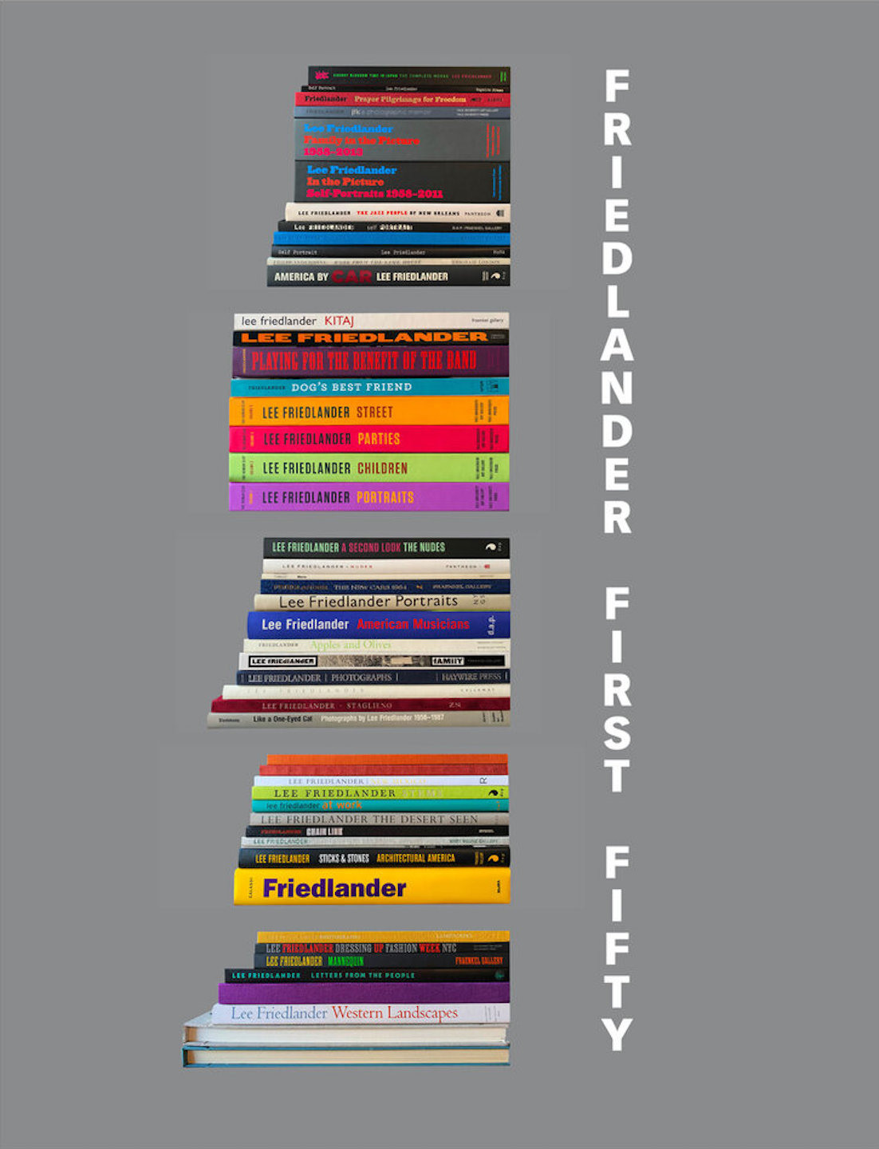
Friedlander First Fifty, The Complete Collection, Limited Edition (with Gelatin Silver Print) [SIGNED]
Used - Hardcover
Condition: Used - As new
US$ 20,000.00

Slide 6
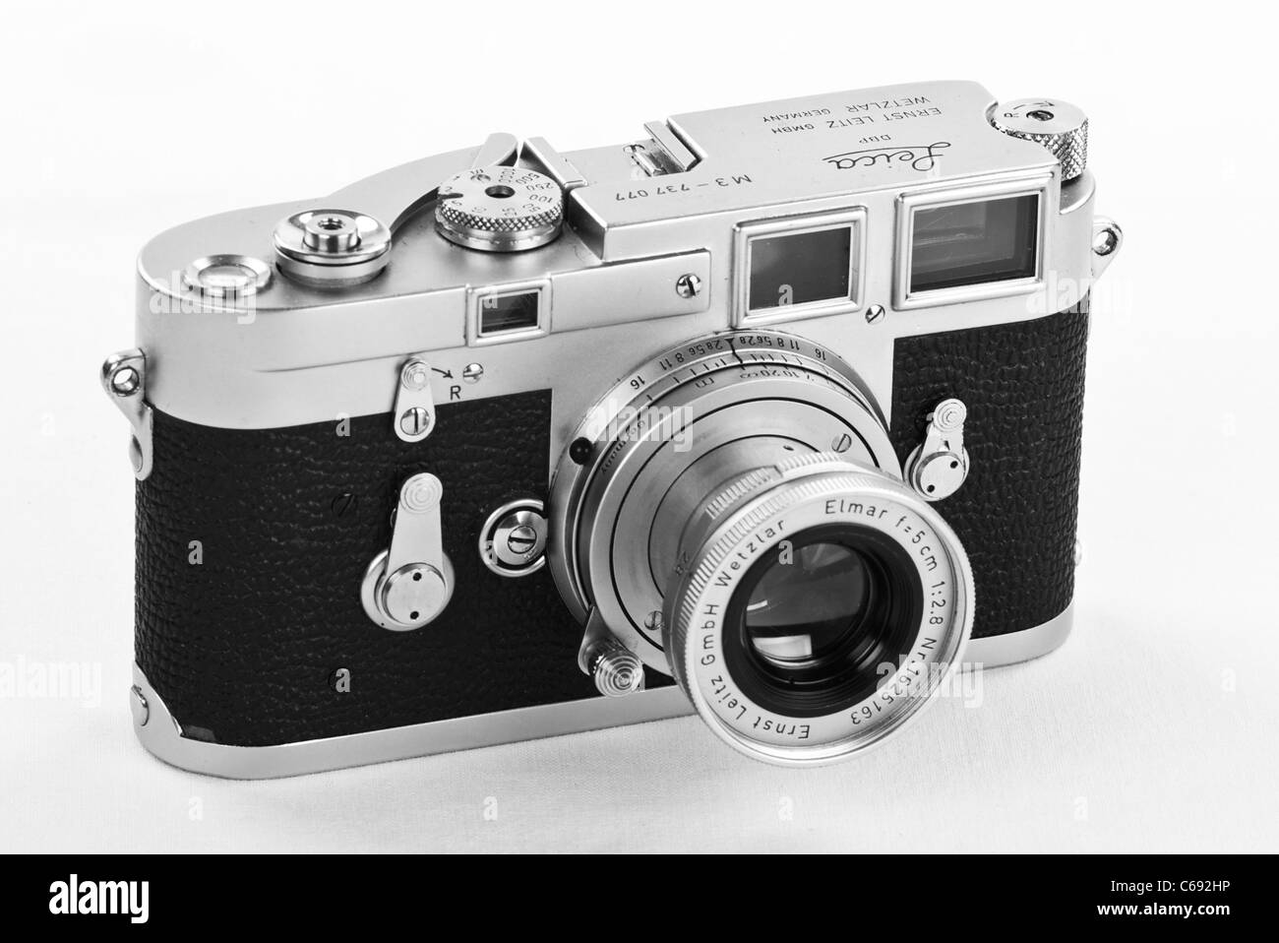
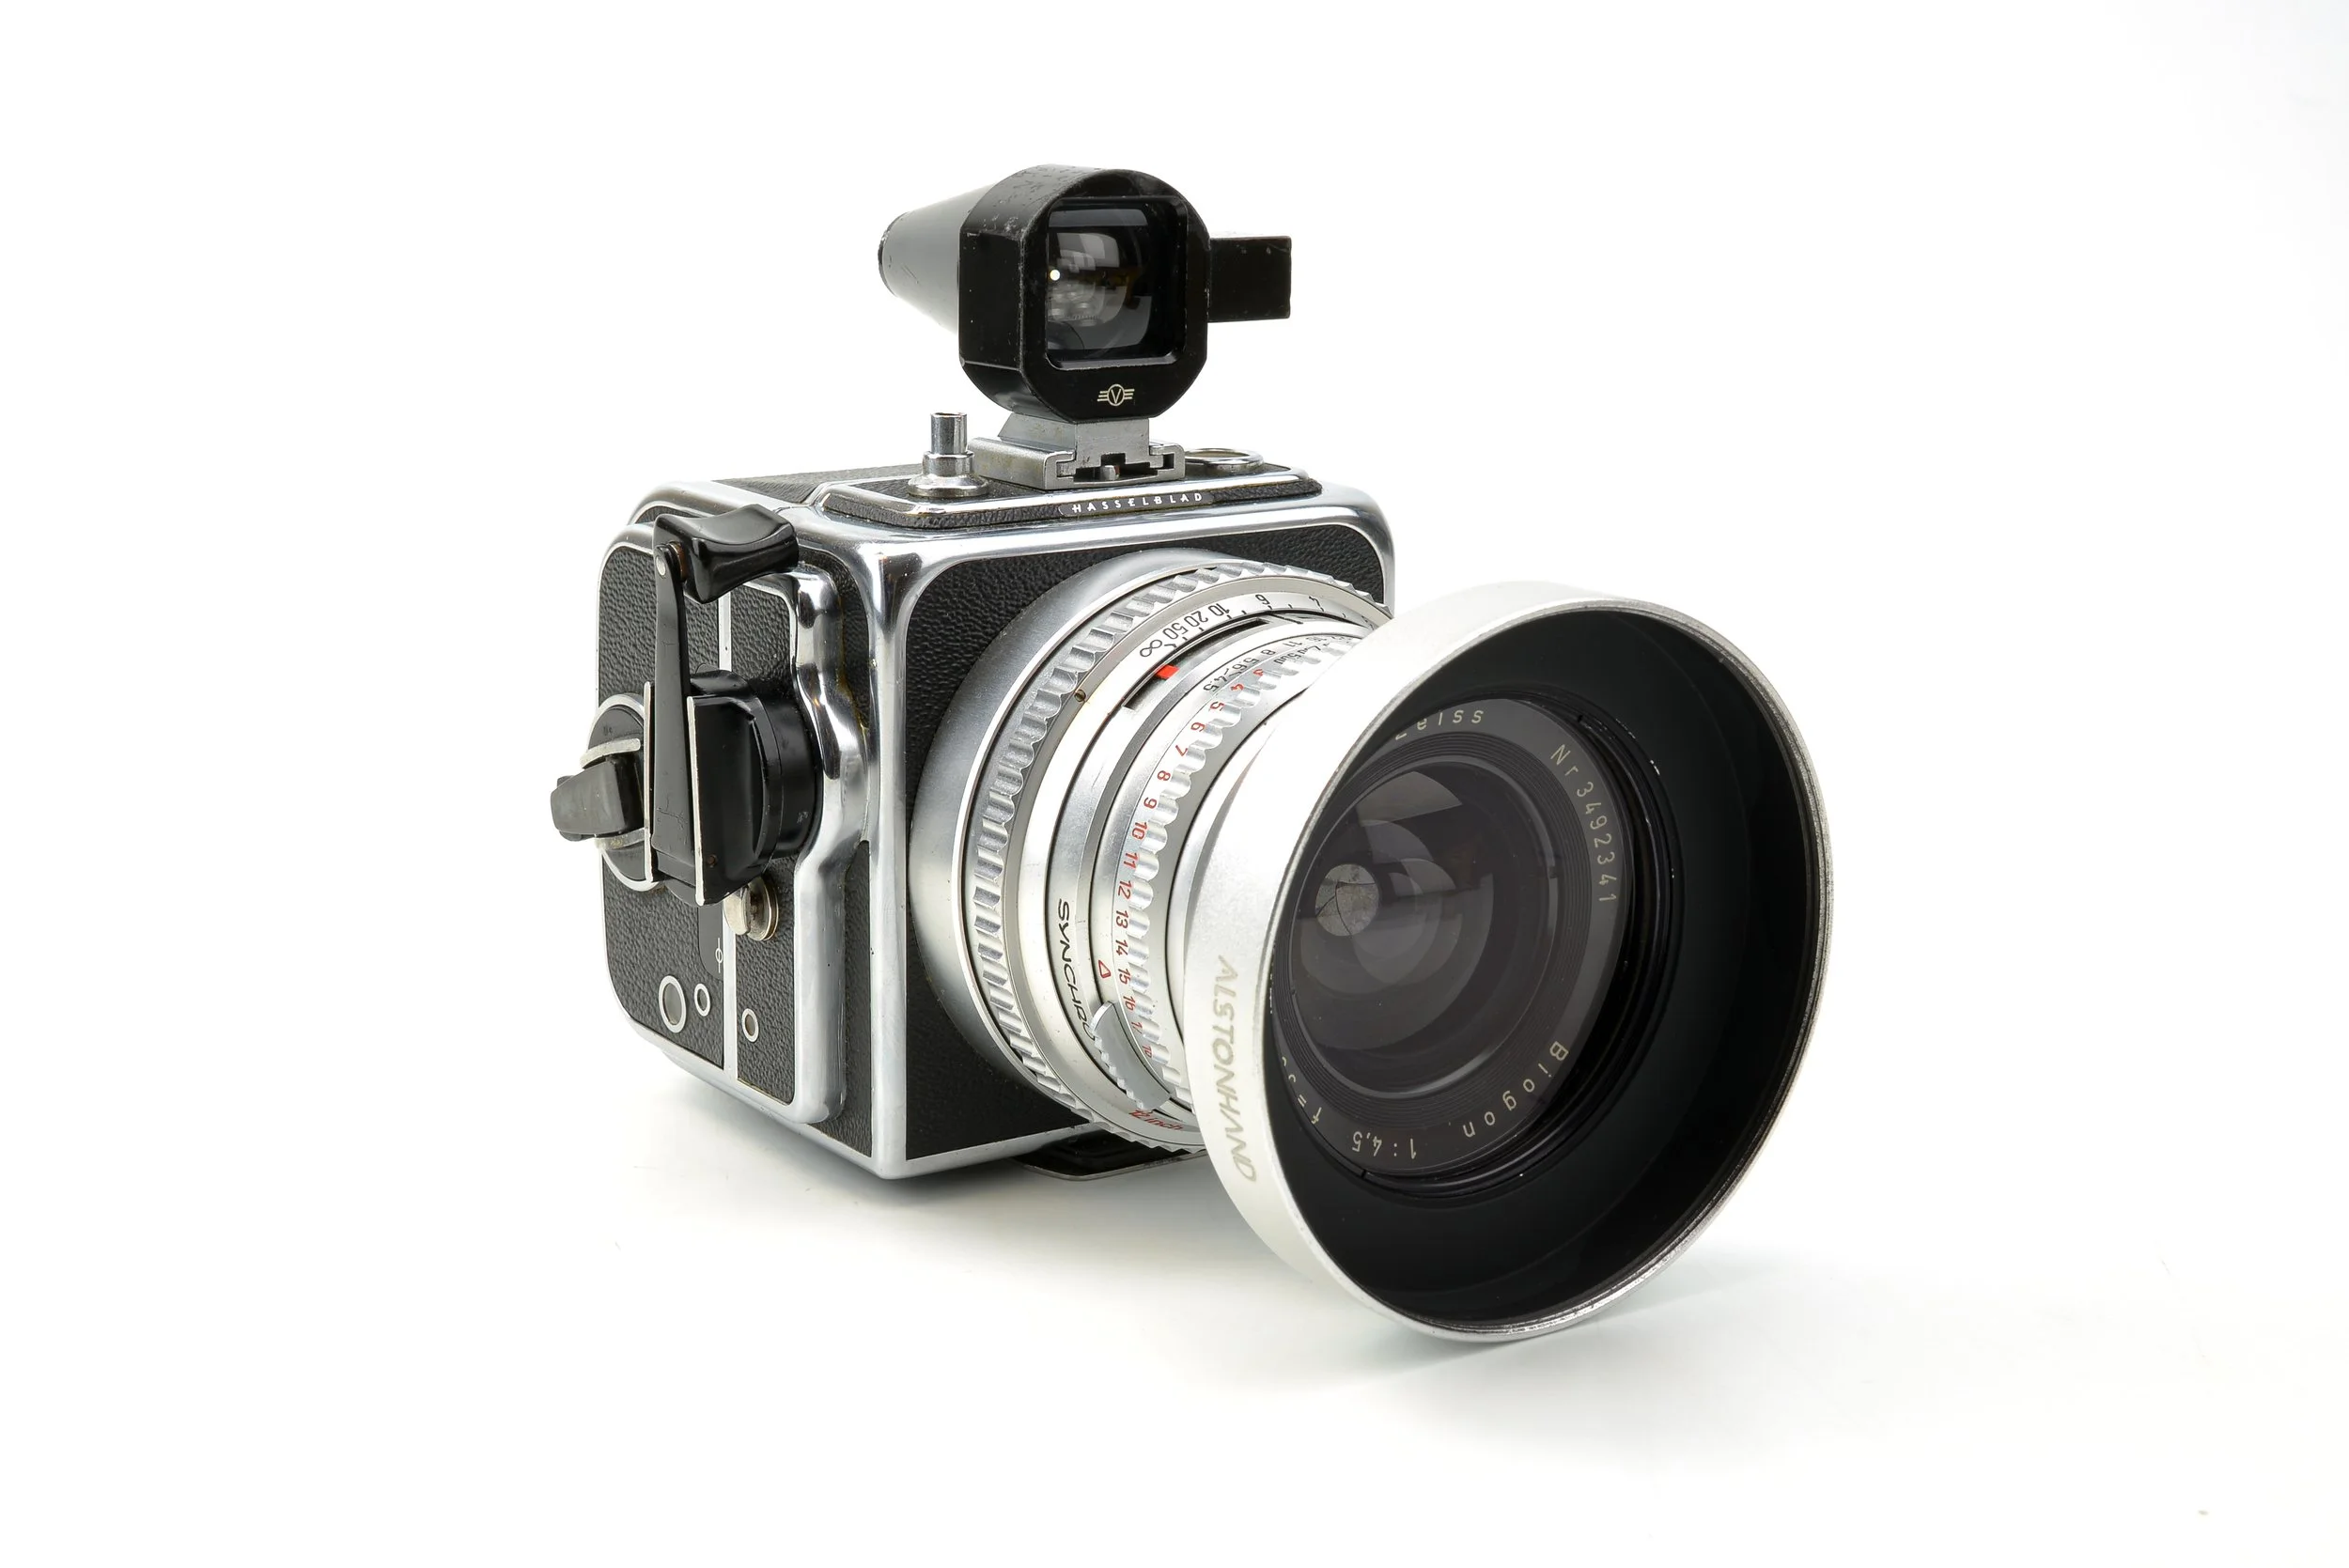
BEFORE YOU ASK…
Q: What camera does Lee Friedlander use?
A: Leica M 35mm rangefinder with 28mm or 35mm lenses.
Some later work with Hassleblad Super Wide C (SWC) with fixed 38mm Biogon lens.
Q: Does he do his own darkroom work?
A: (As of 2023), he does his own darkroom work in the basement of his home at 52 South Country Road in New City, New York.

Slide 7
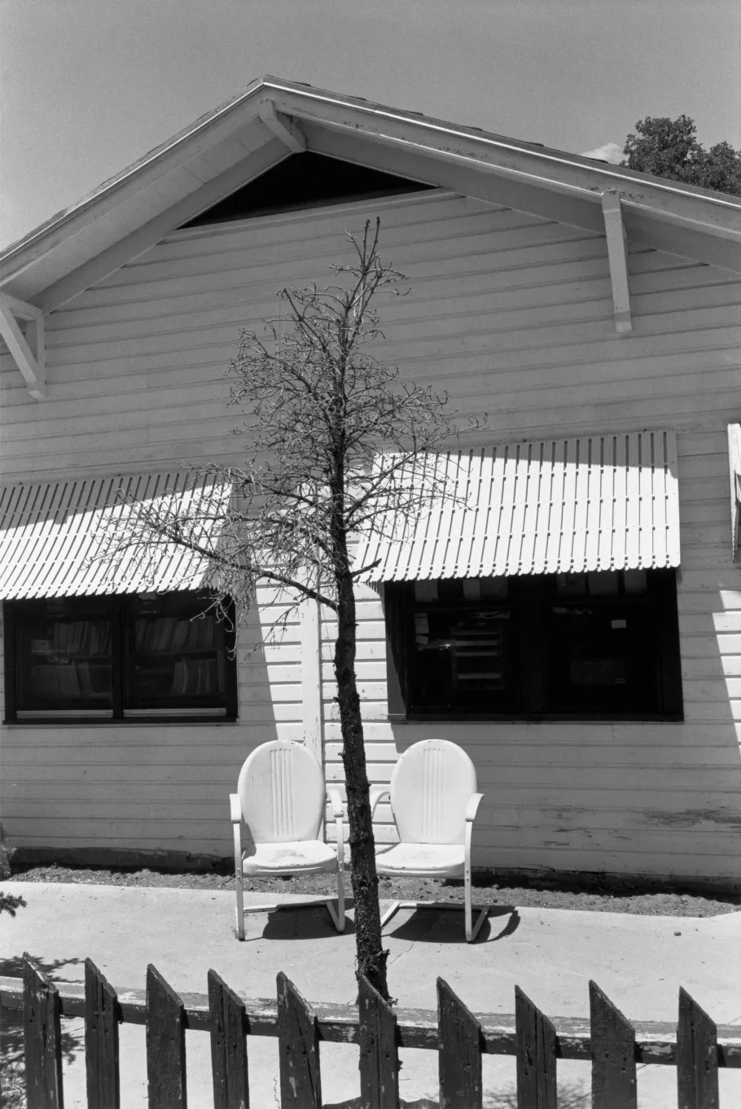
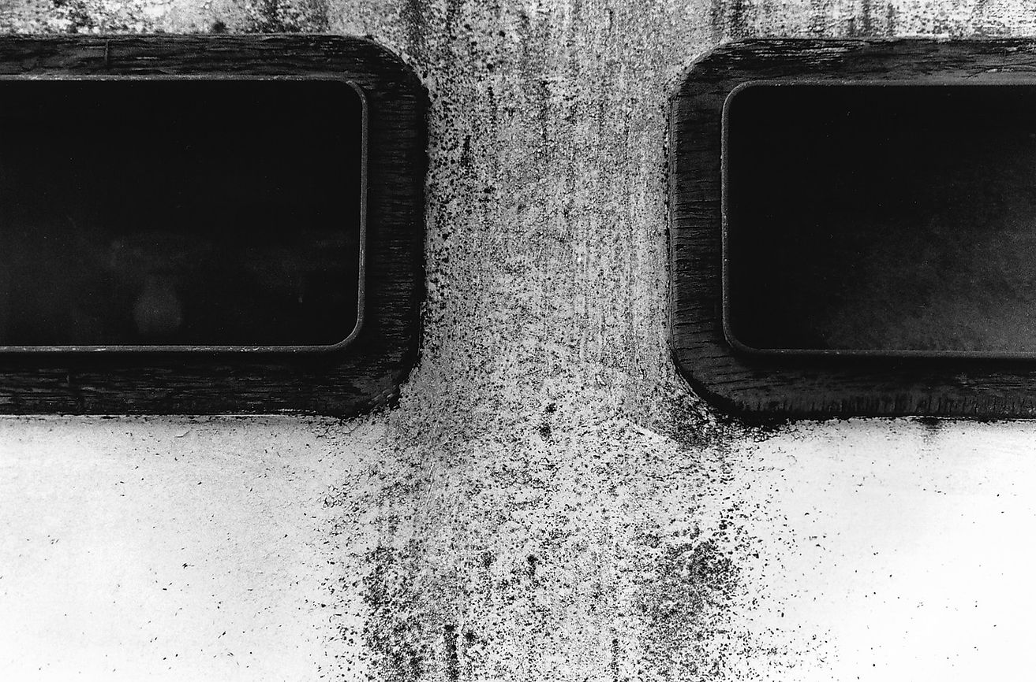
Albuquerque, New Mexico,1975
VERTICALS
me

Slide 8
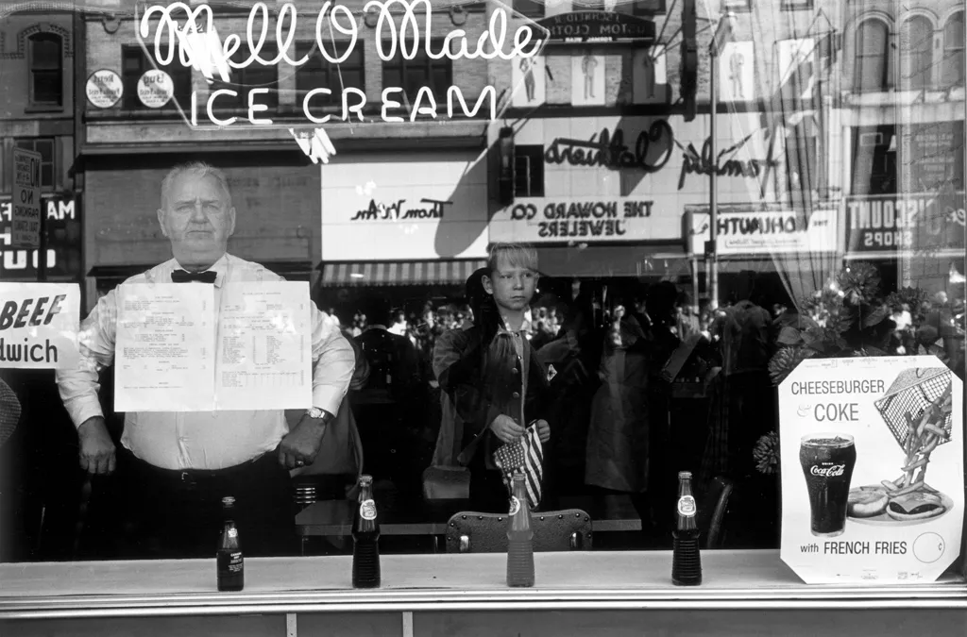
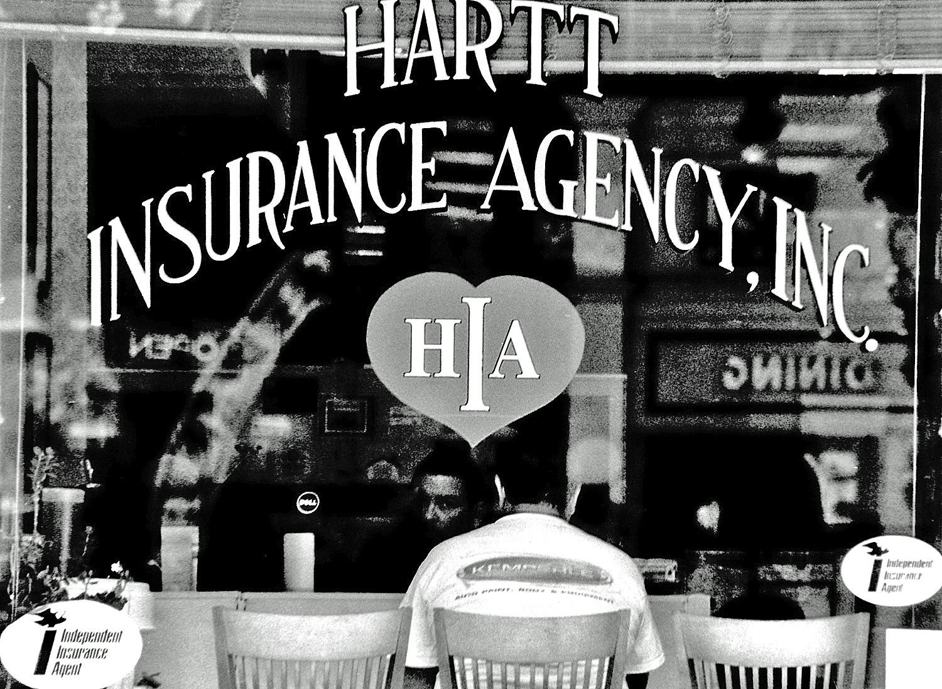
Newark, N. J., 1962
me

Slide 9
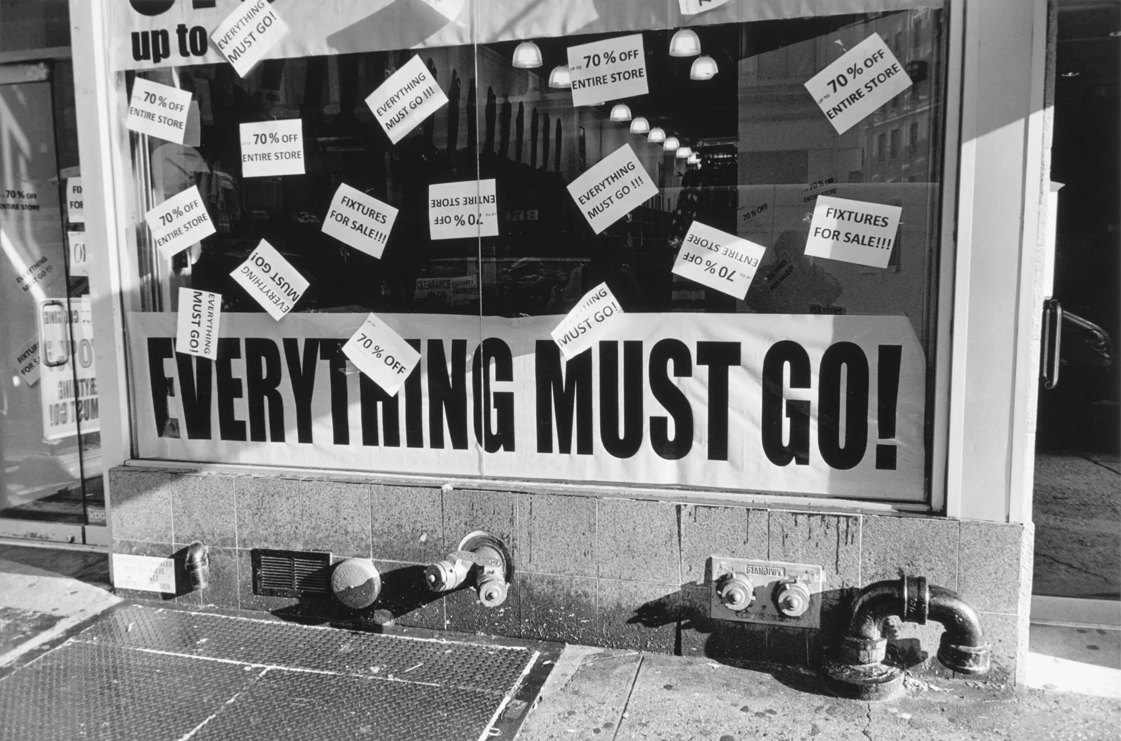
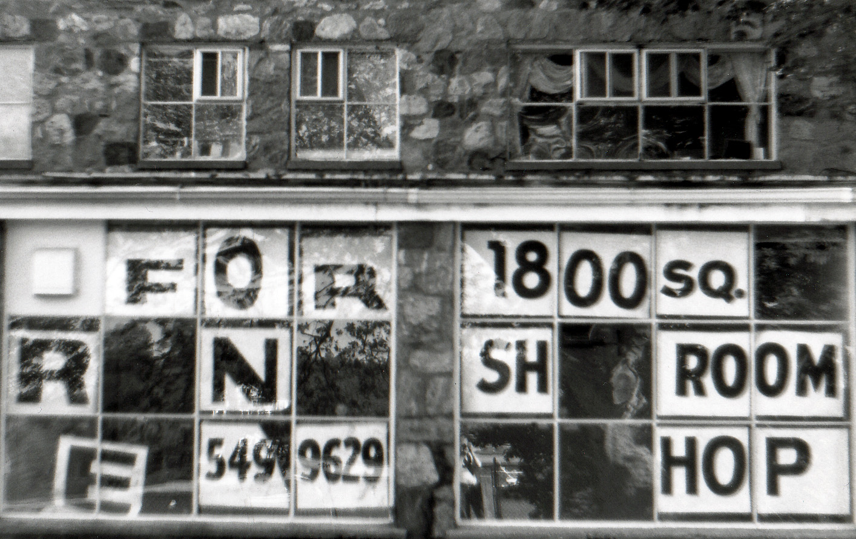
New York City, 2013
SIGNS
me

Slide 10
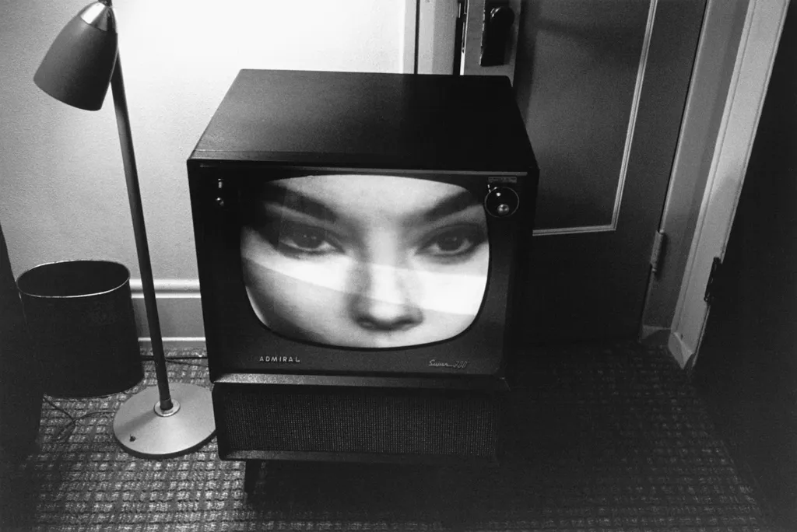
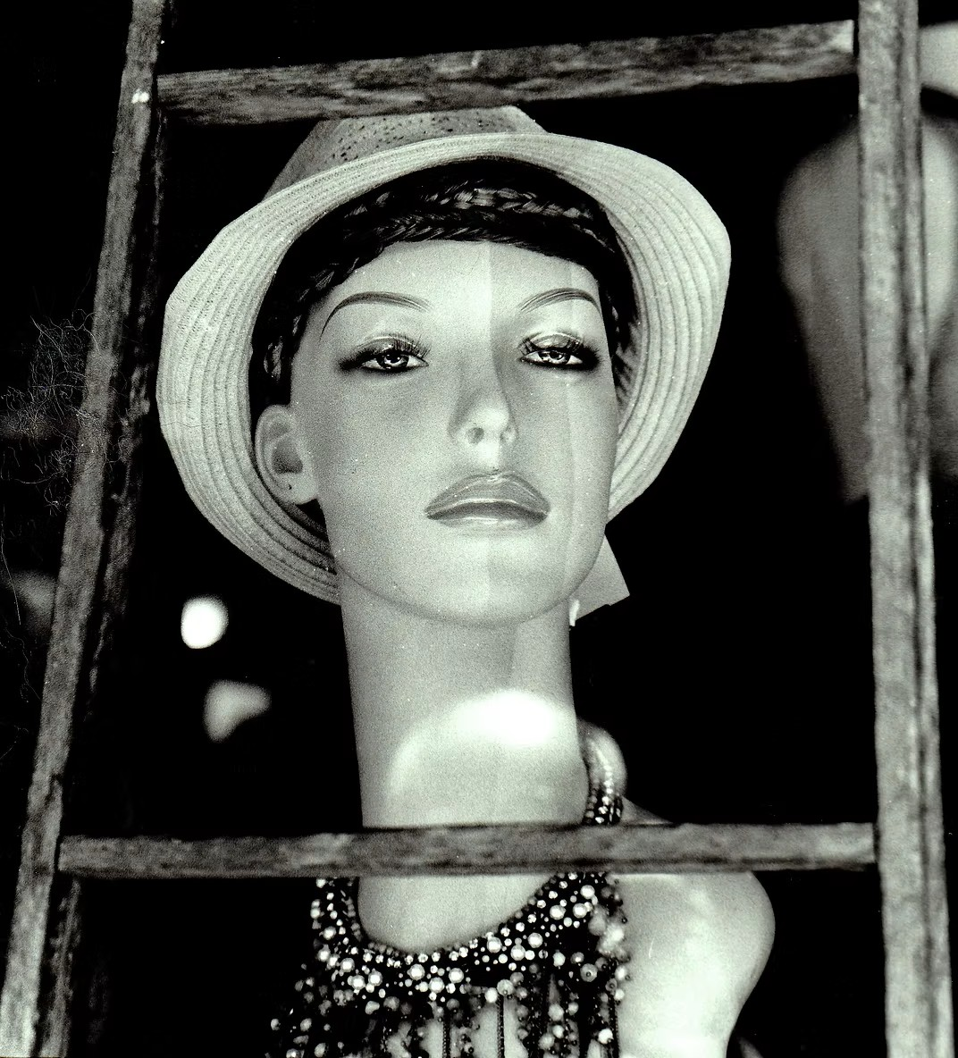
Florida, 1962
Little Screens
me

Slide 11
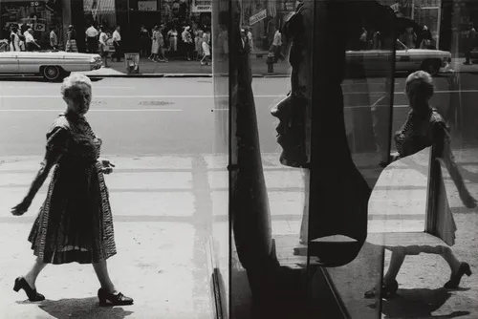
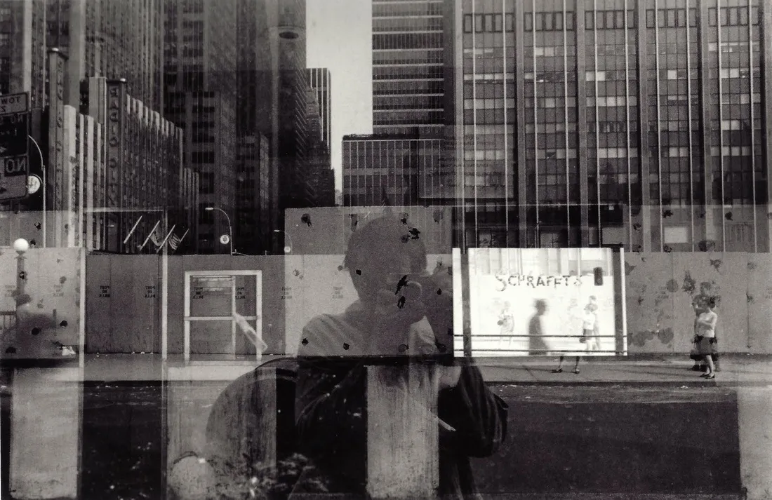
Mirrors and Reflections
“These are impossible compositions. How does it happen that these things that seem to be so impossible are so perfect?”
Joel Coen, filmmaker

Slide 12
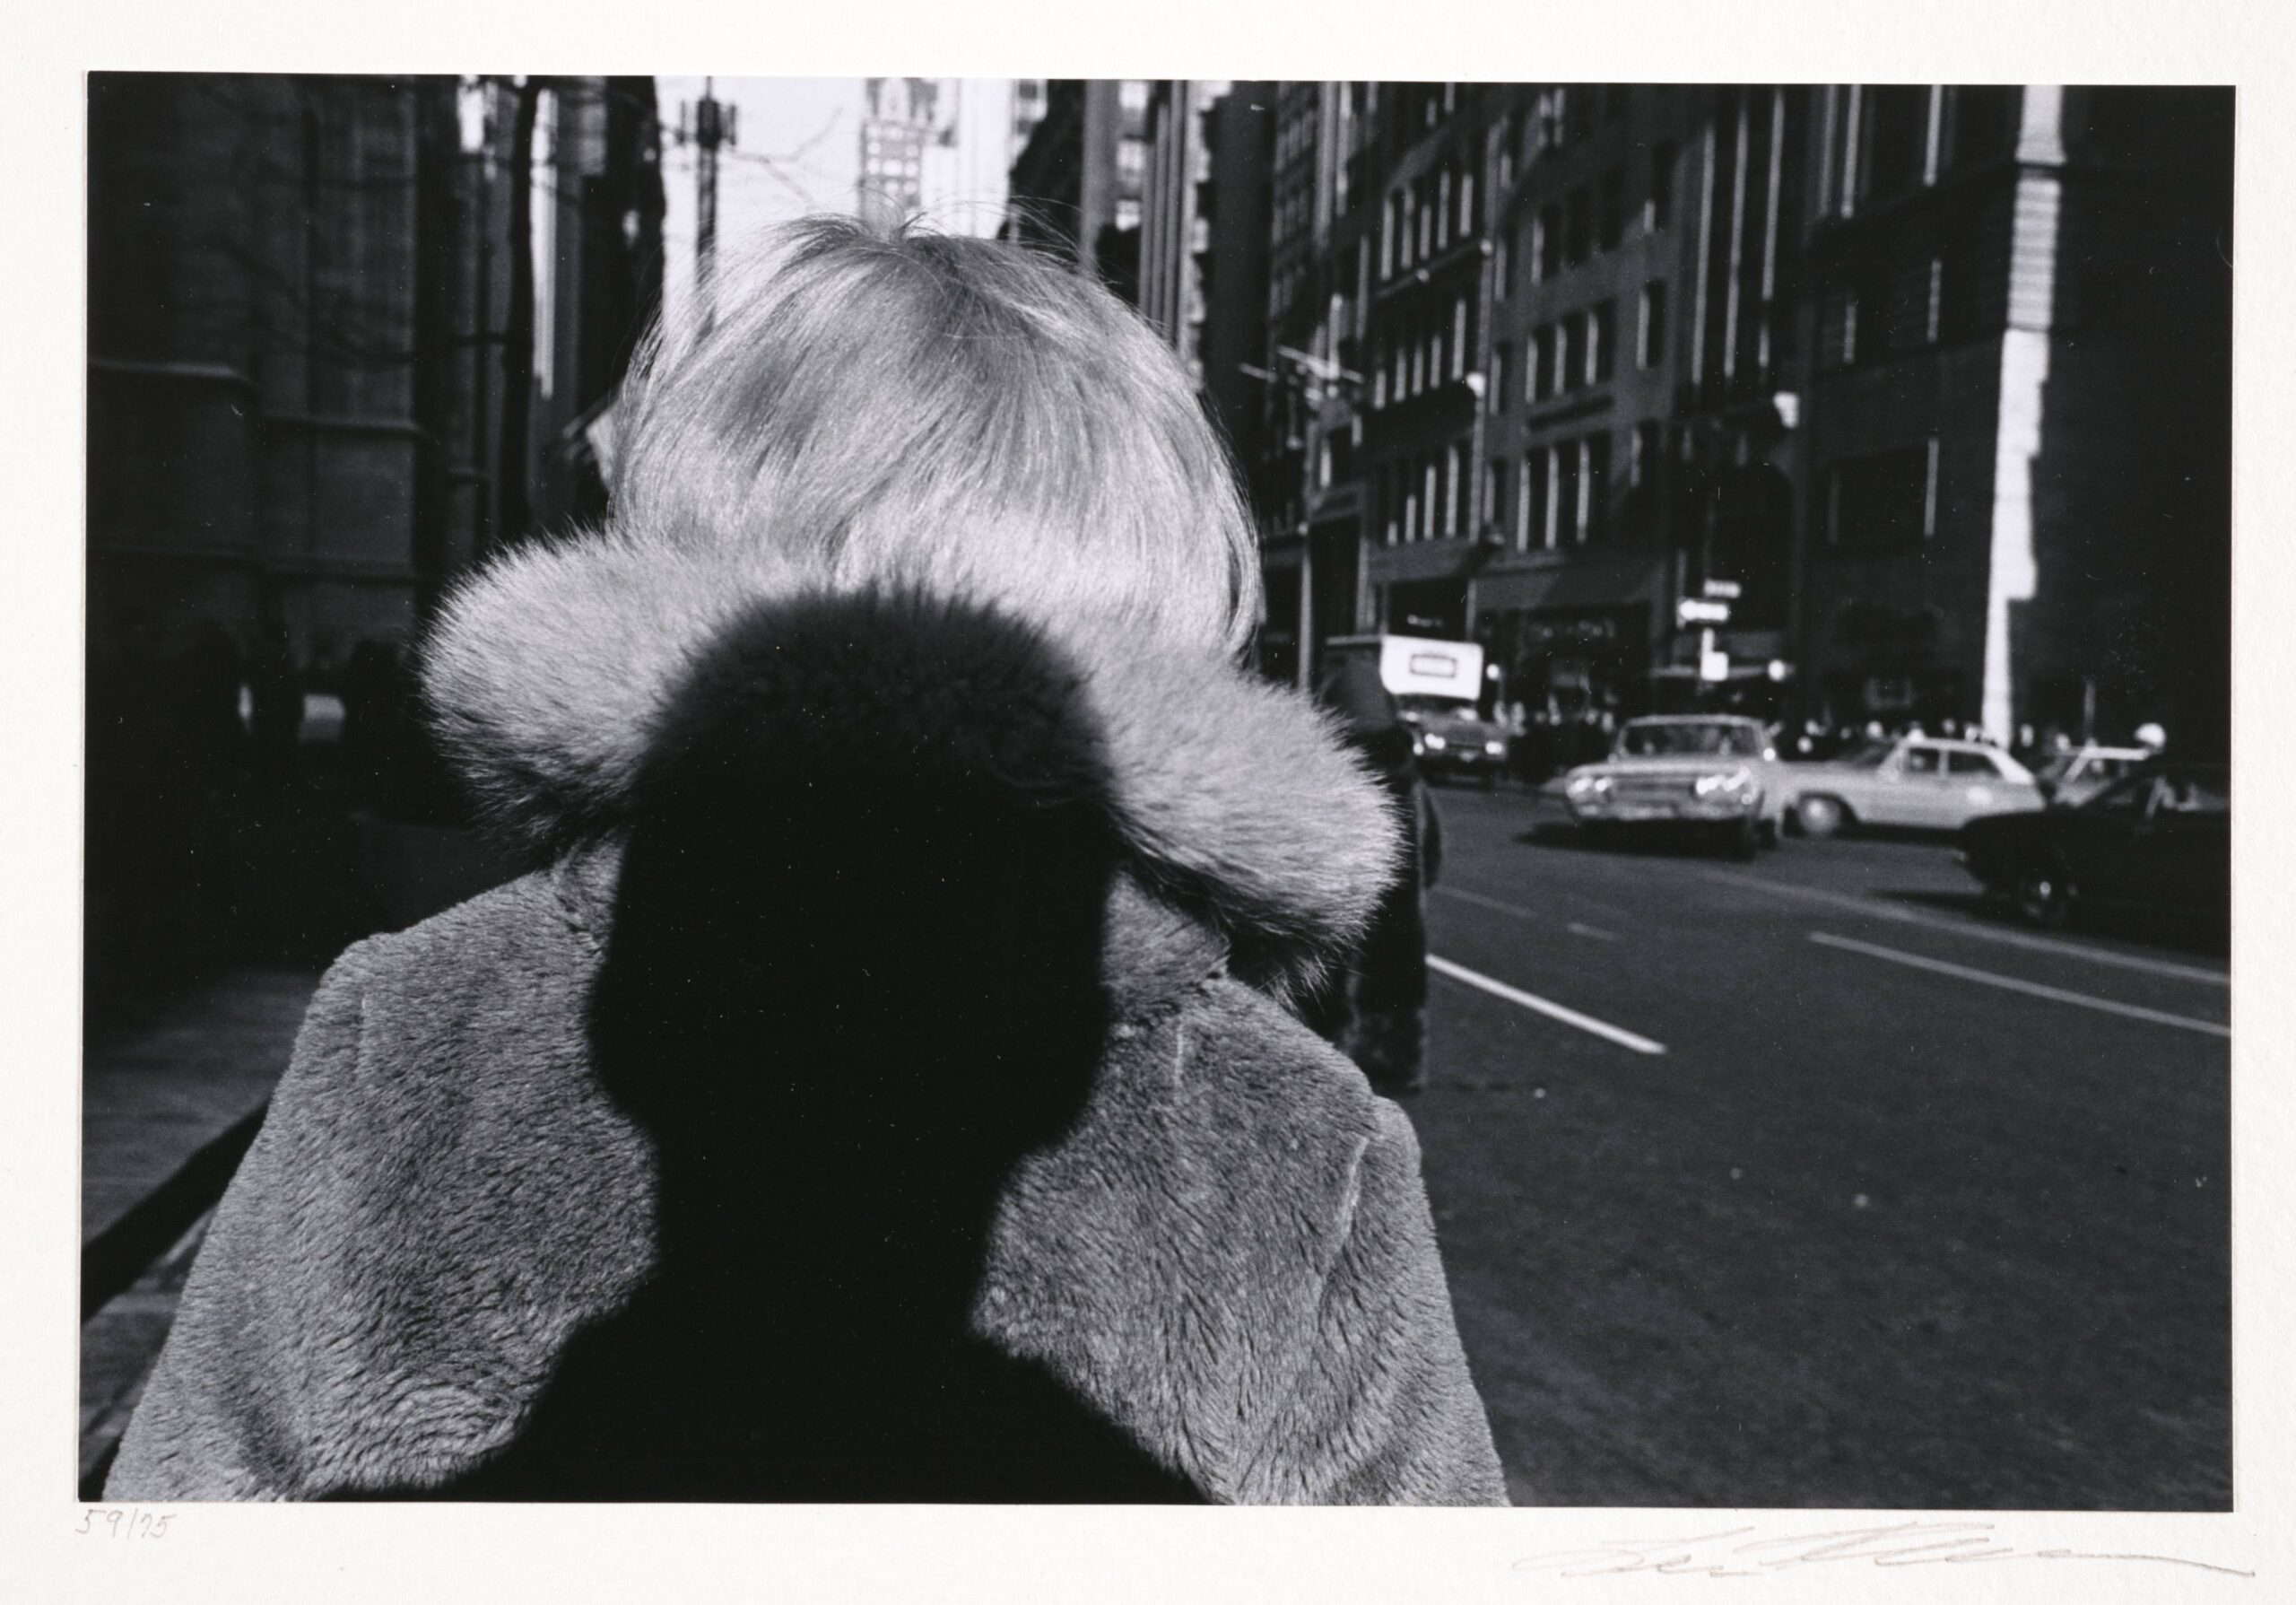
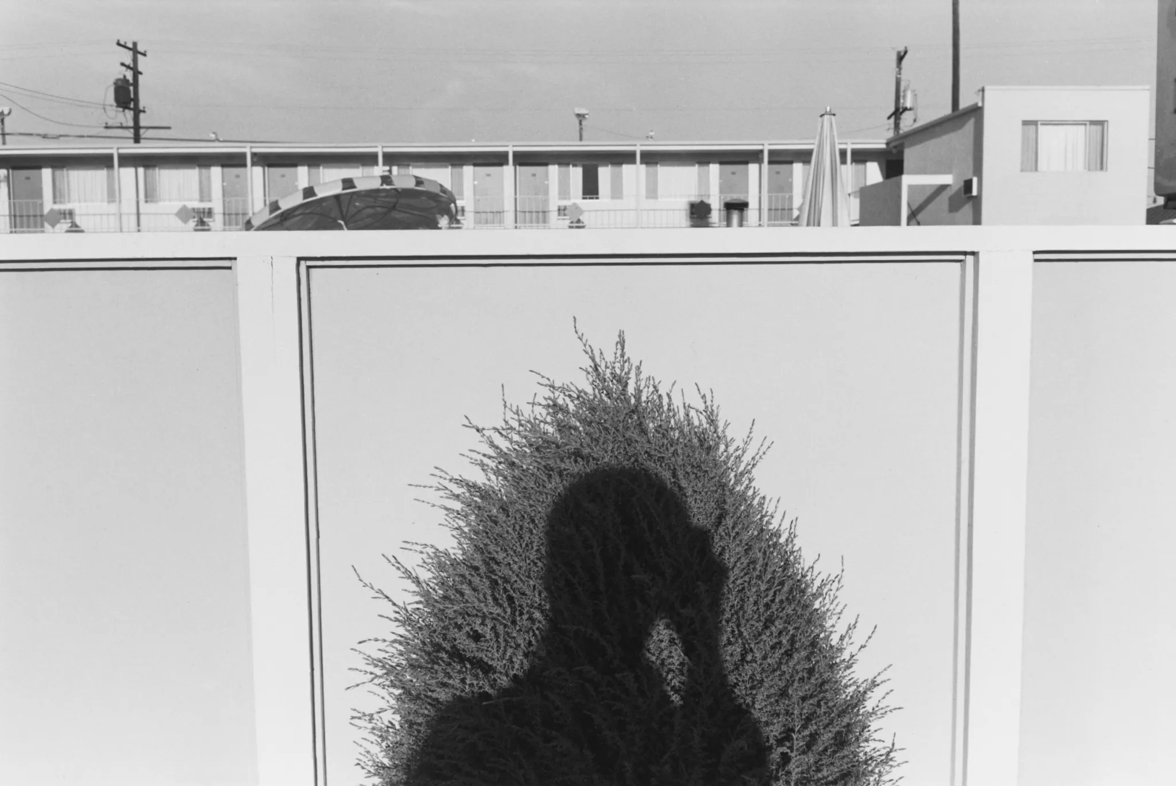
Shadows
"Friedlander worked six years on that shadow to recognize that street photography is never an invisible act. Someone is there, someone chooses, someone throws a shadow on the wall they are photographing."

Slide 13
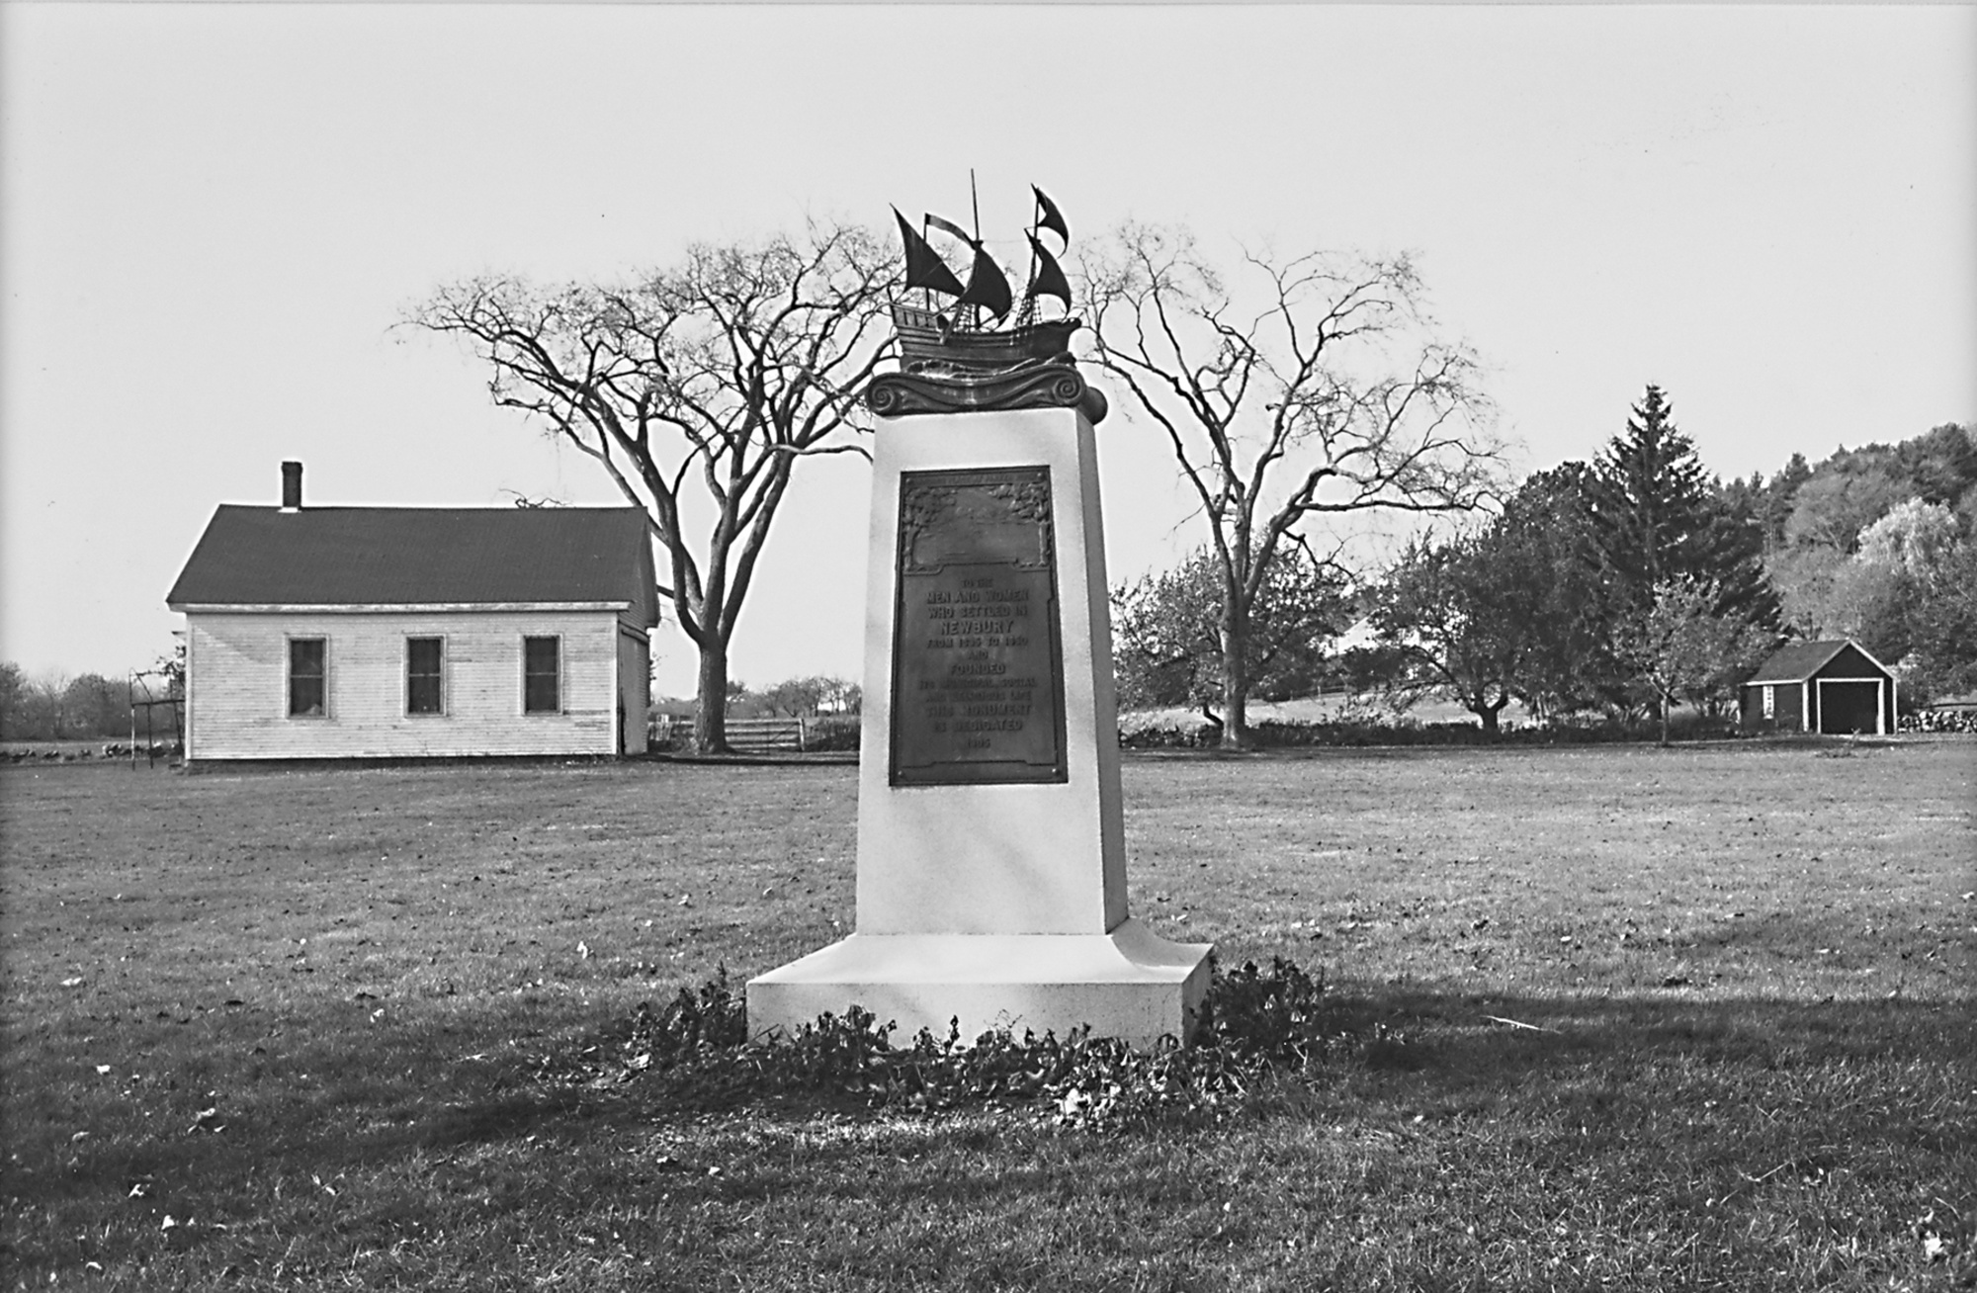
“Friedlander’s approach is as various as his prey. In some pictures he gives us the simple thing as simple as could be imagined: a plaque on a rock seen head-on, filling the frame. For others he stands back, or splays his view to accommodate the surrounding scene, bustling with indifference or emptied by neglect.”
Peter Galassi
Newbury, Mass from The American Monument, 1976

Slide 14
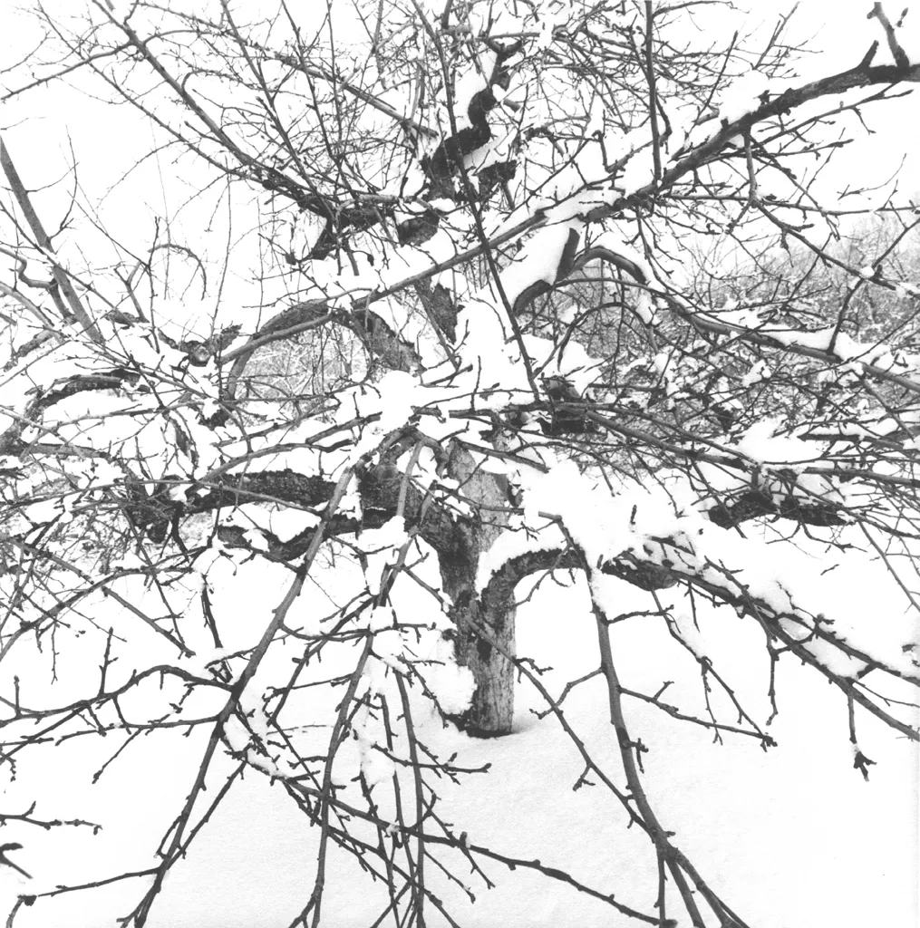
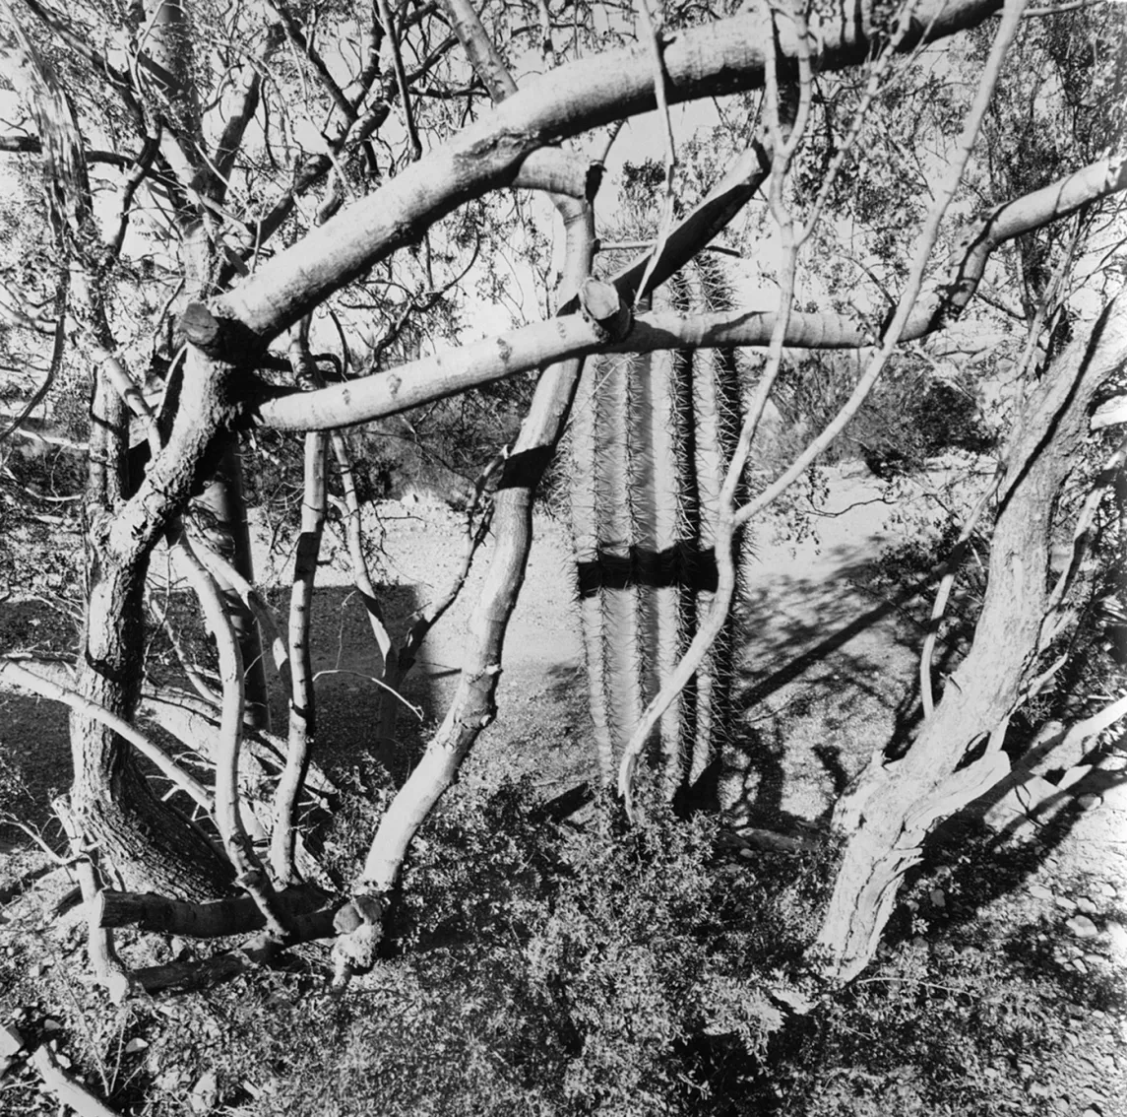
Landscapes
New City, 2003
Sonora Desert, Arizona, 1994

Slide 15
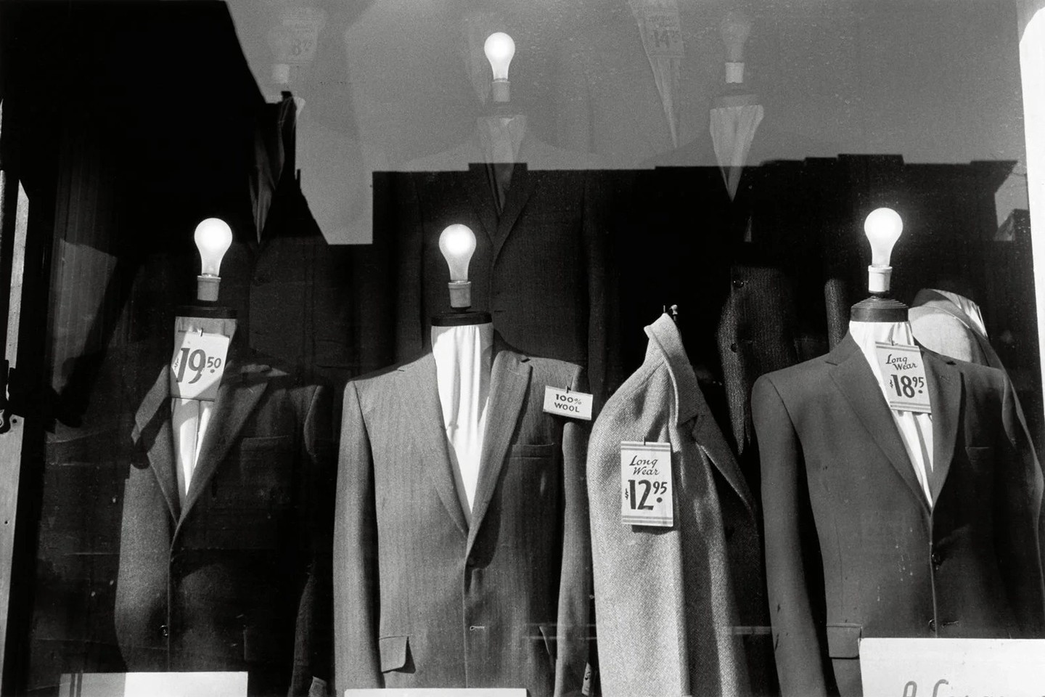
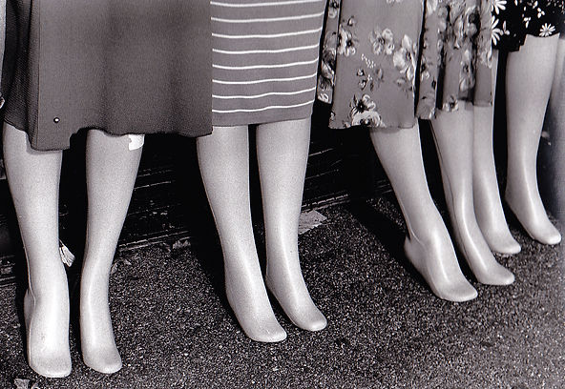
Mannequin
me
Life Still, 2013

Slide 16
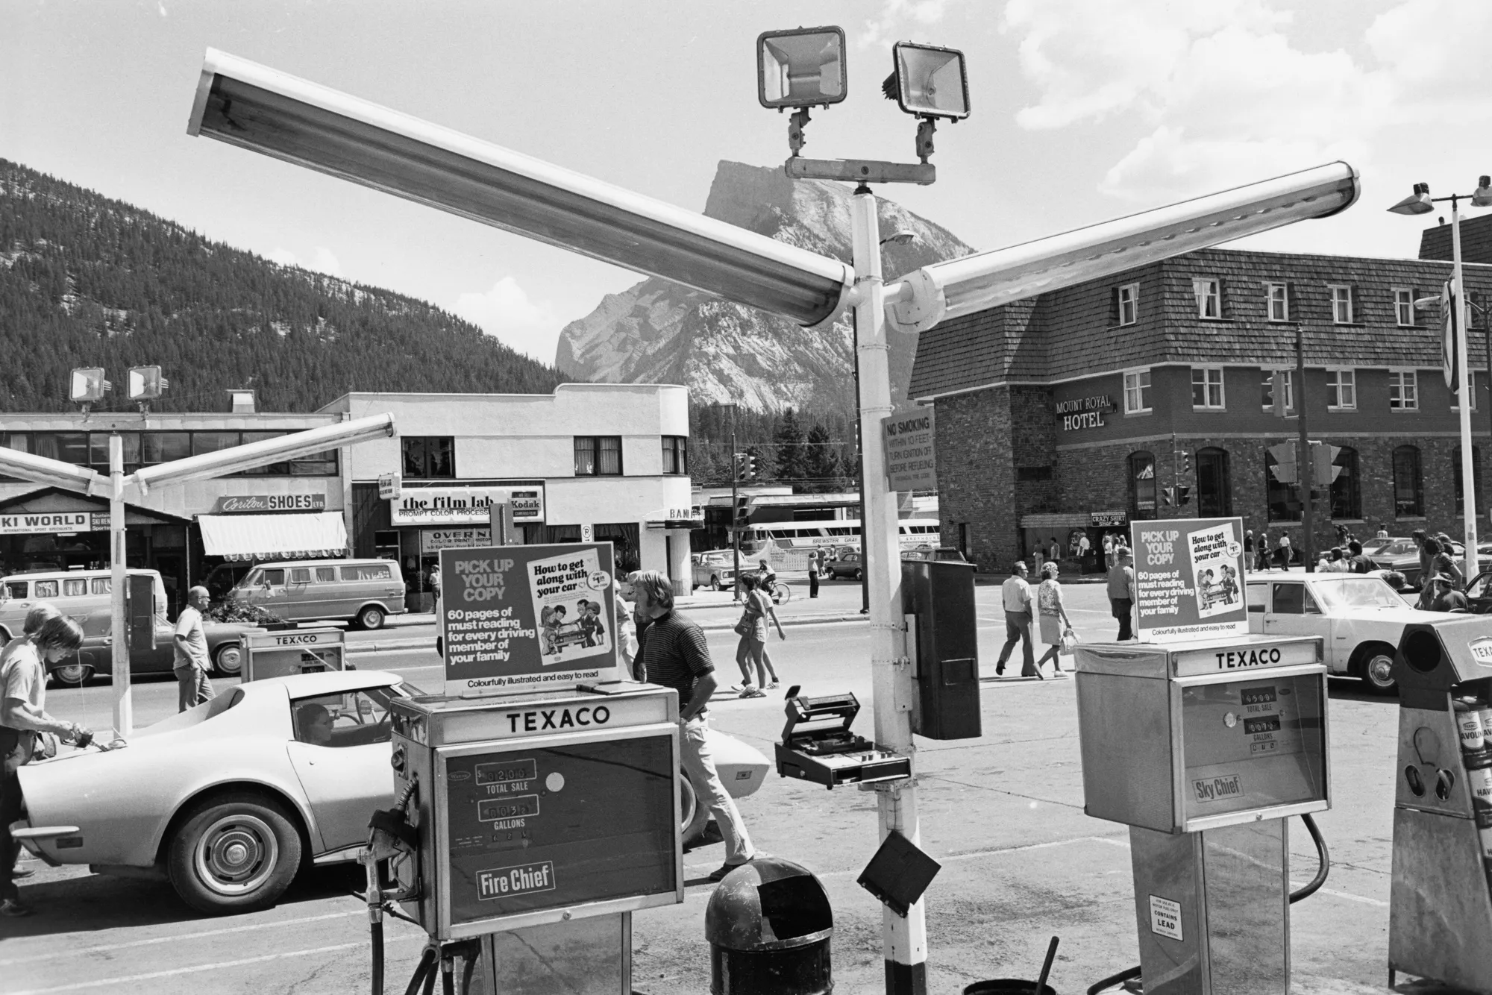
There’s something quietly radical about the way Lee Friedlander sees the world—nothing is ever presented cleanly or simply. His images are layered, interrupted, full of reflections, shadows, and frames within frames. At first glance they can feel chaotic, but the longer you look, the more intentional they become.
Studying his work when I was a photo student shifted how I think as a photo director today. Instead of chasing perfect compositions, I became more interested in complexity—how elements can overlap, obscure, and still tell a clear story. Friedlander’s approach gave me permission to lean into imperfection: a shadow cutting across a subject, a reflection revealing something secondary, a moment that feels slightly off but more real because of it.

Slide 17
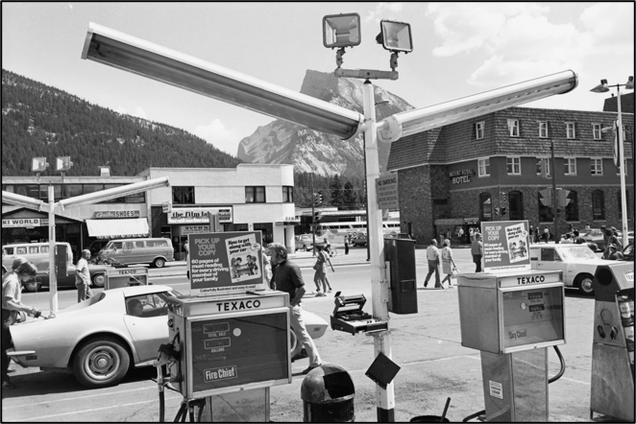
Banff, Canada, 1974

Slide 18
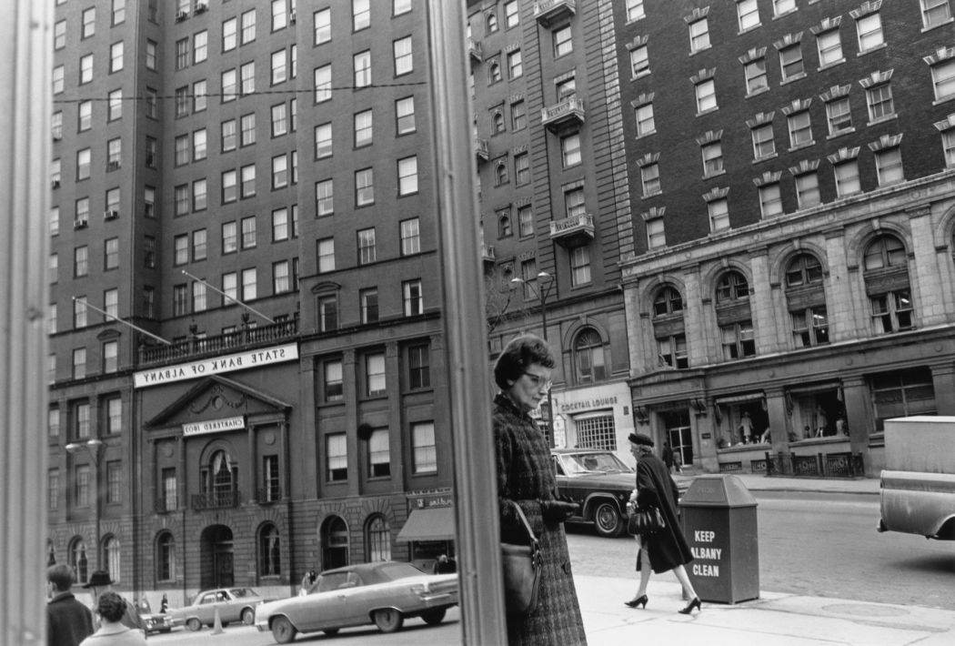
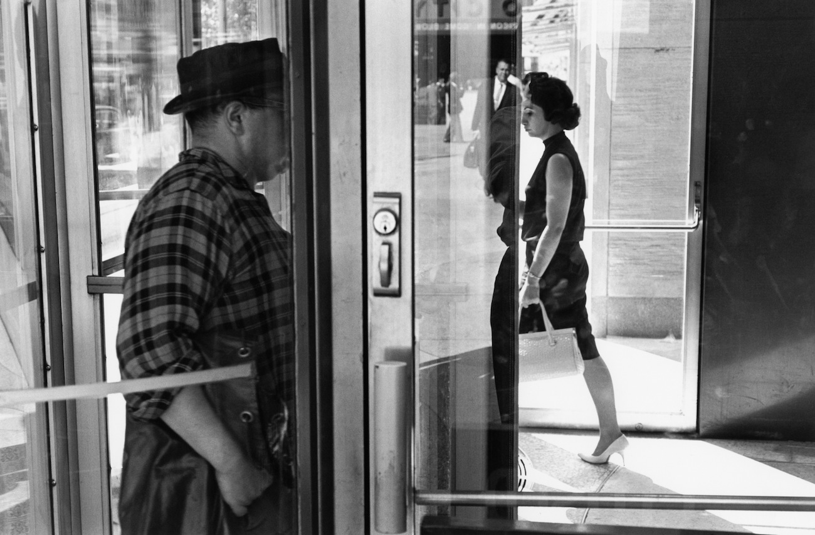
The Dividing Line
Rather than using lines merely for clean geometry, Friedlander uses them to subvert traditional photographic conventions. They act as barriers and boundaries, highlighting the psychological distance of modern society, while acting as the unifying threads that hold his complex scenes together.
Inspired Eye

Slide 19
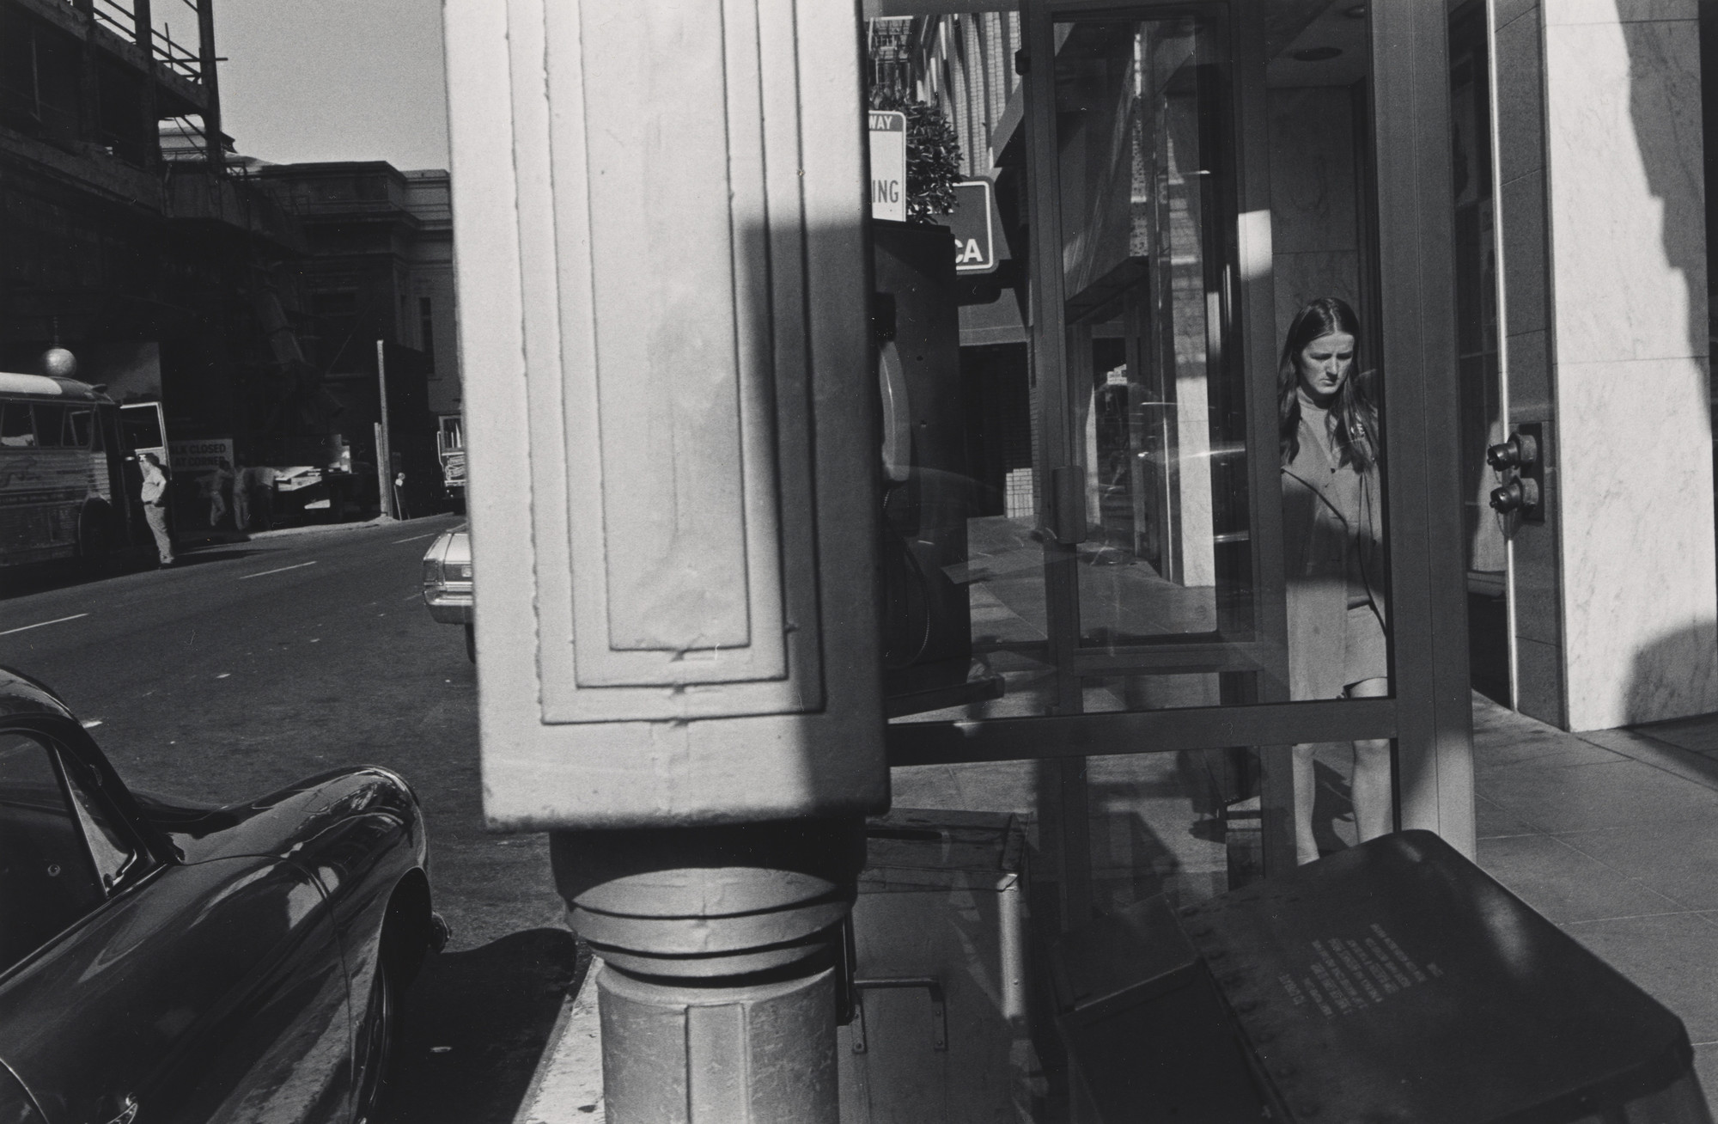
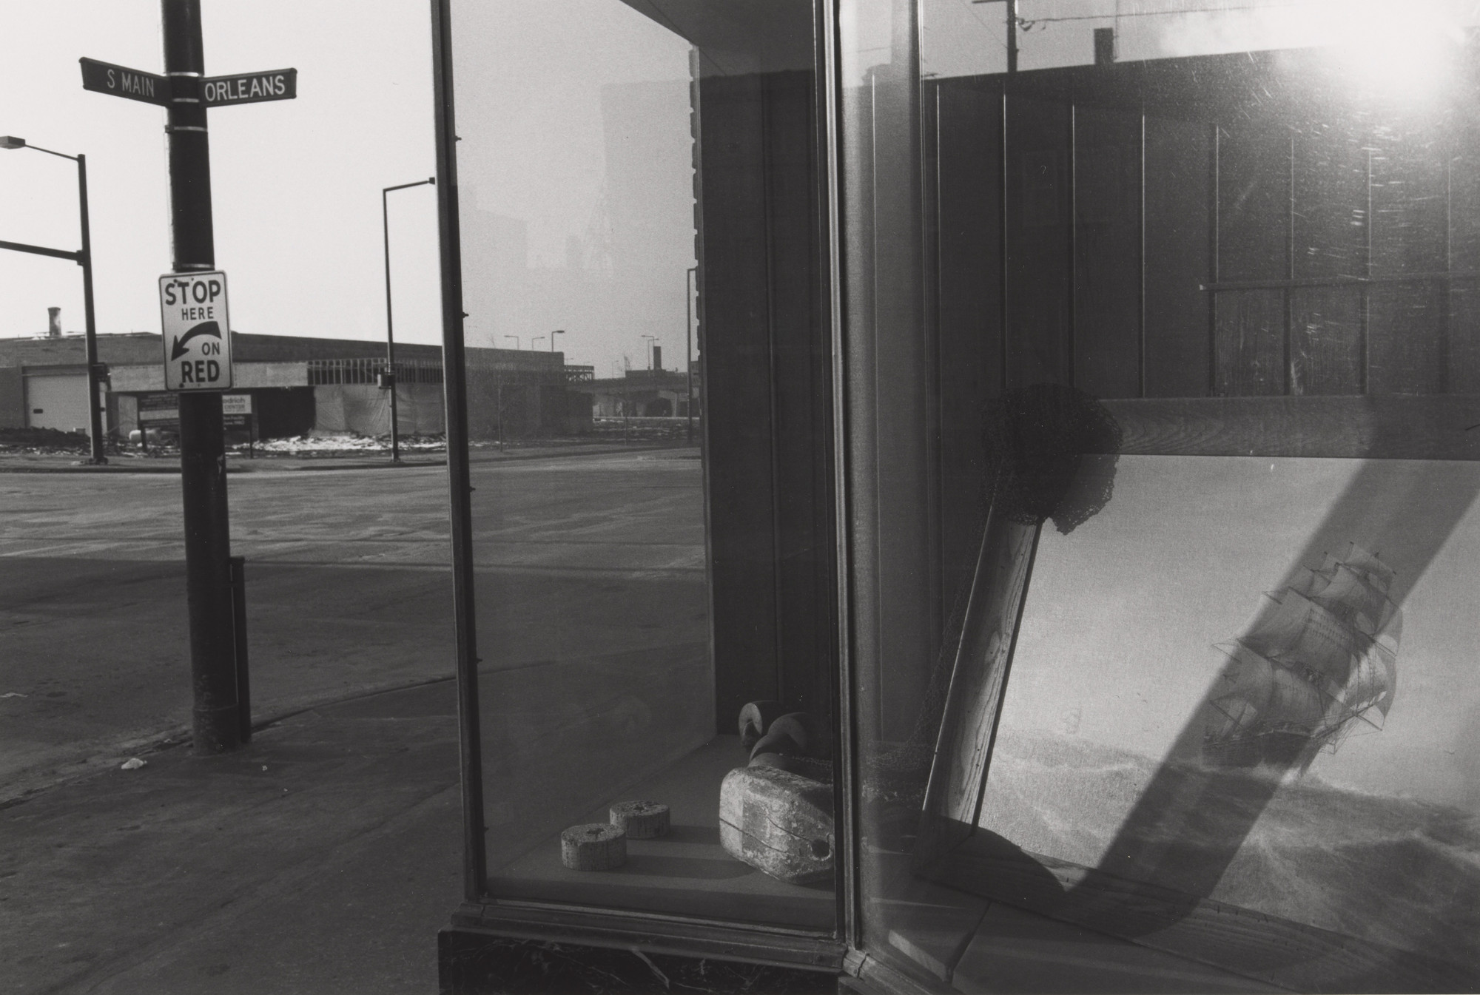
The Dividing Line Page 2
Lee Friedlander uses dividing lines to fragment space, create tension, and organize visual chaos. By using architectural and environmental elements like fence posts, windows, and reflections, he disrupts traditional compositions, turning the frame into a dynamic, multi-layered puzzle.
Black & White Magazine

Slide 20
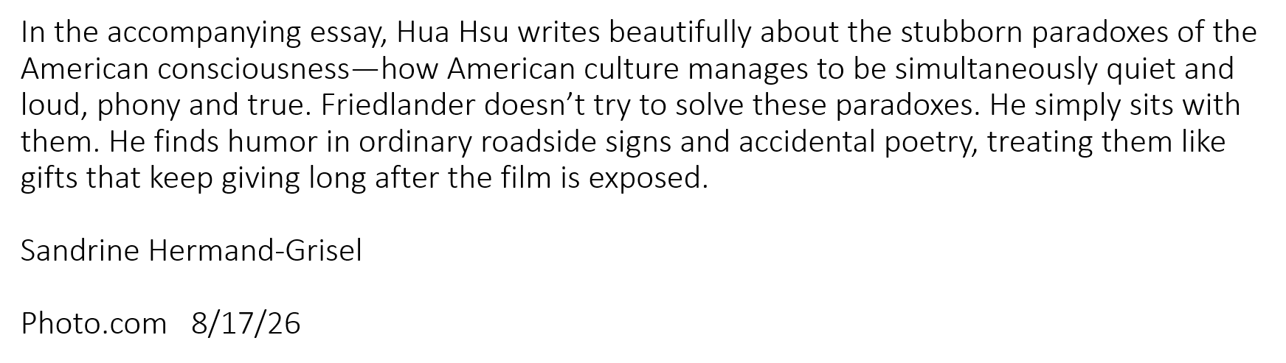
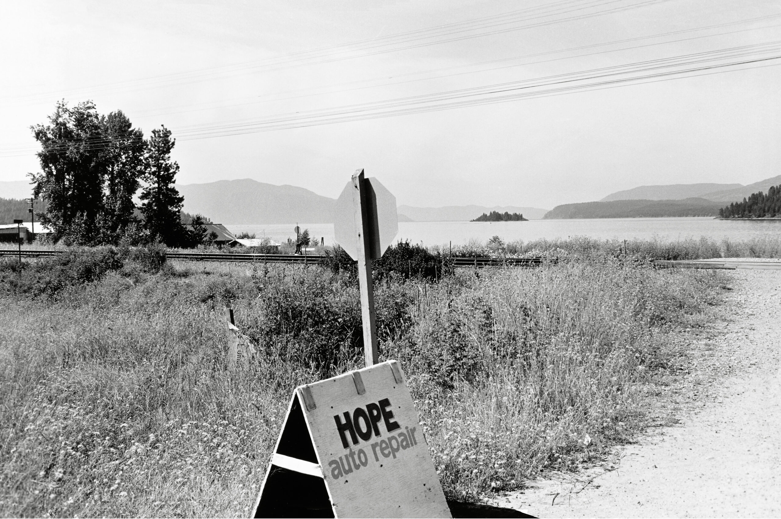
Montana, 1974
From Life Still

Slide 21
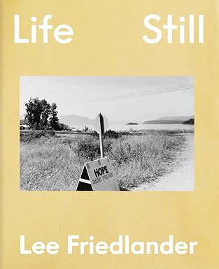
In his first Aperture monograph, Life Still, Lee Friedlander reimagines the presentation of his oeuvre at age ninety-one, bringing together rarely seen and unpublished images from the past sixty years alongside new work to stage a visual dialogue between past and present.
Published April 26, 2026
Available on Amazon $49

Slide 22
FOUR LESSONS
From the International Hall of Fame and Museum
Induction of Lee Friedlander Class of 2026

Slide 23
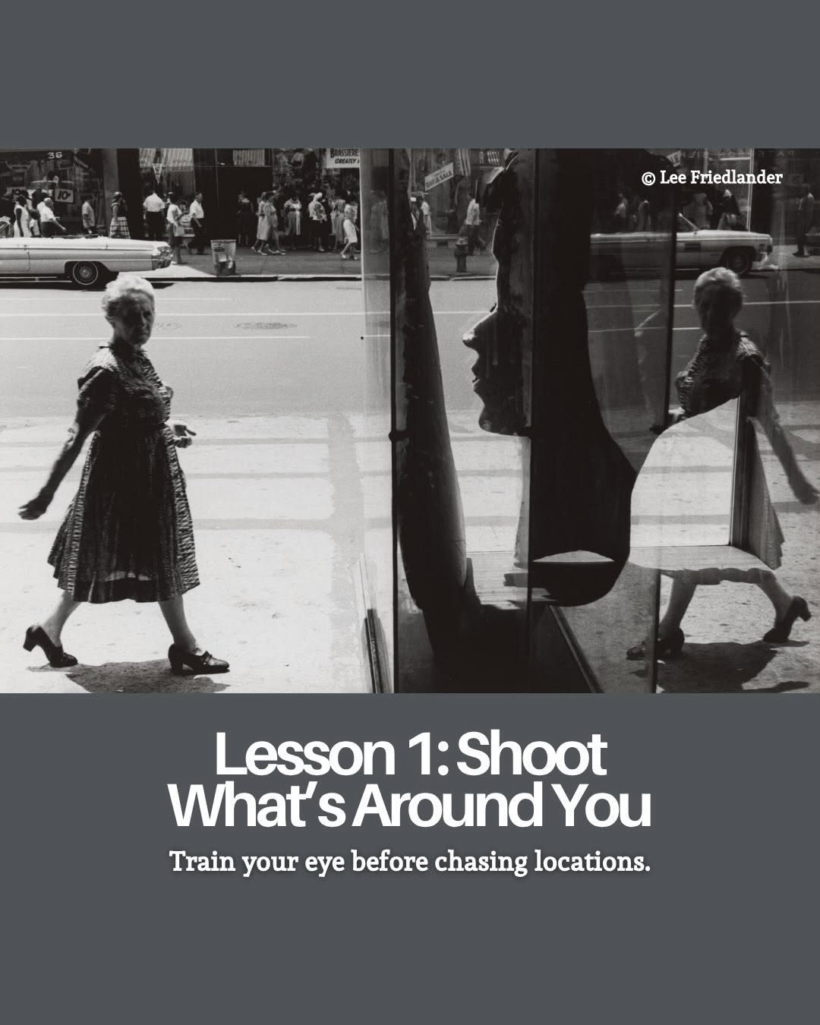

Slide 24
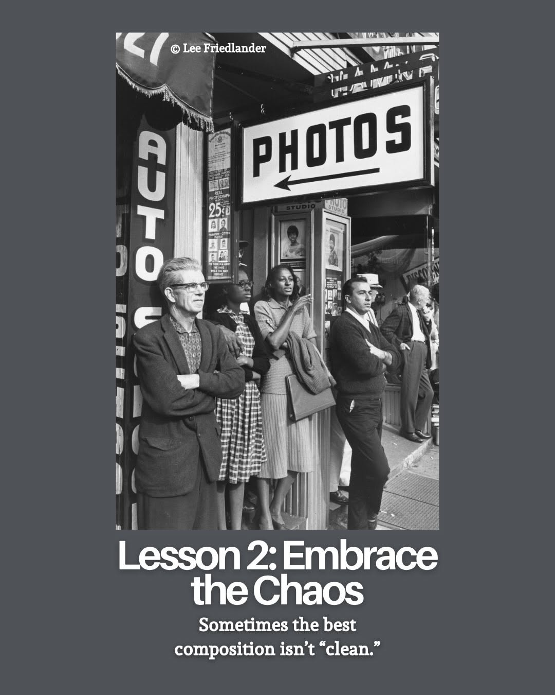

Slide 25
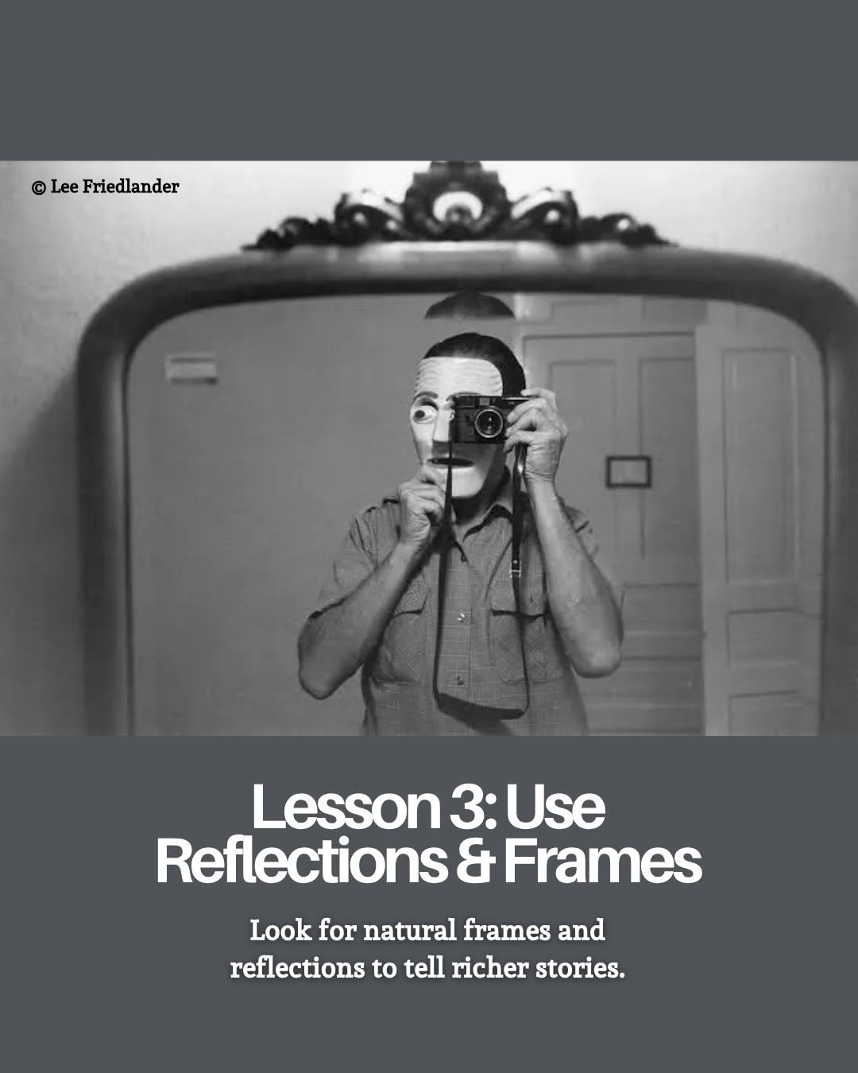

Slide 26
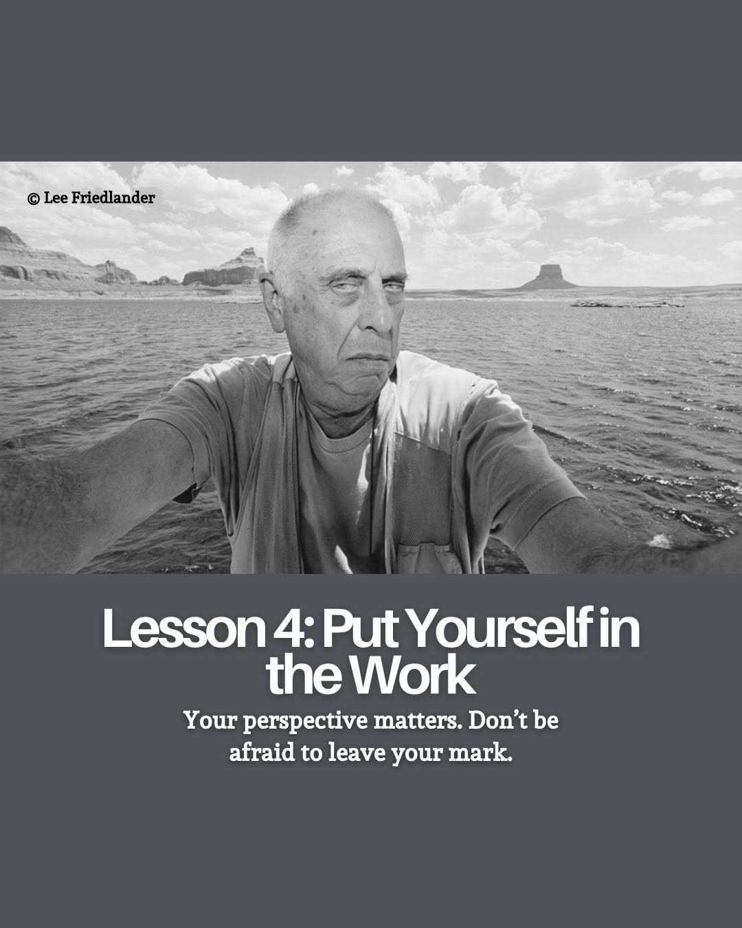

Slide 27
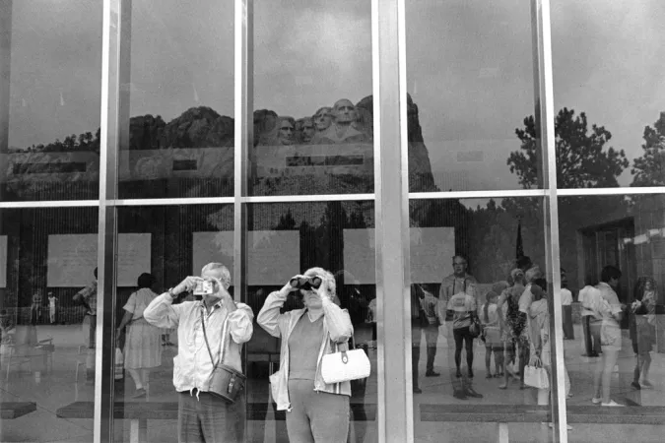
Mount Rushmore, South Dakota, 1969

