Slide 1
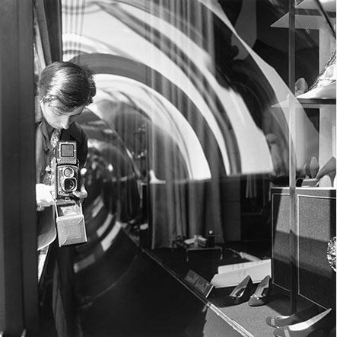
Vivian Maier
Here and Not Here
February 1, 1926 – April 21, 2009

Slide 2
THE FACTS
BORN: February 1, 1926 New York City
MOTHER: Maria Jaussard Justin FATHER: Charles (AKA Wilhelm) Maier
RESIDENCES: NY, The Bronx, Saint-Julien-en-Champsaur, CHICAGO North Side
OCCUPATION: Nanny and Caregiver
1956-72: The Gensburg Family
1967-73: The Raymond Family
1959-60: Worldwide travels to Southeast Asia, Middlle East, Central and Western Europe
The Maloof Collection: 100,000-150,000 negatives, 3,000 vintage prints, hundreds of rolls of film, 30 home movies, tape interviews, cameras, paperwork etc. etc.
Cameras: Kodak Brownie, Rolleiflex 6x6, Leica IIIc, German SLRs

Slide 3
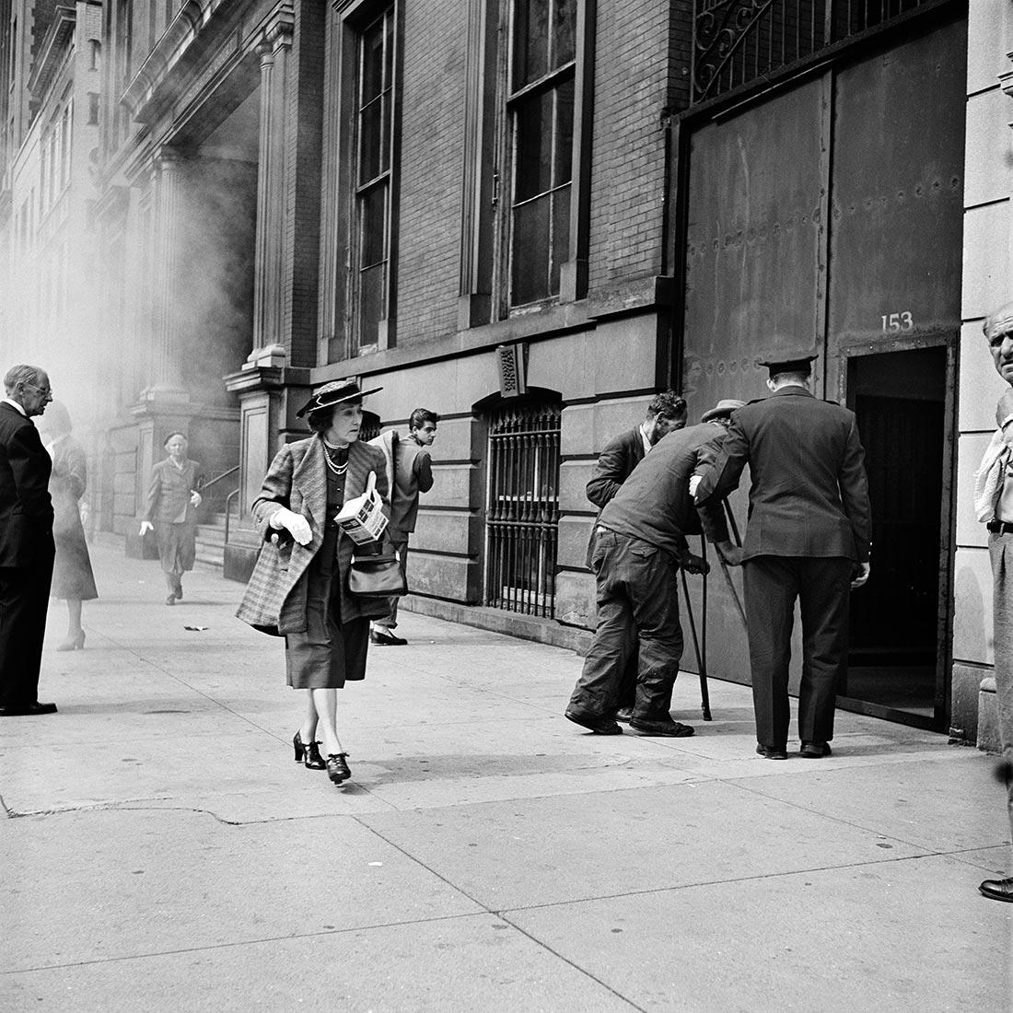

Slide 4
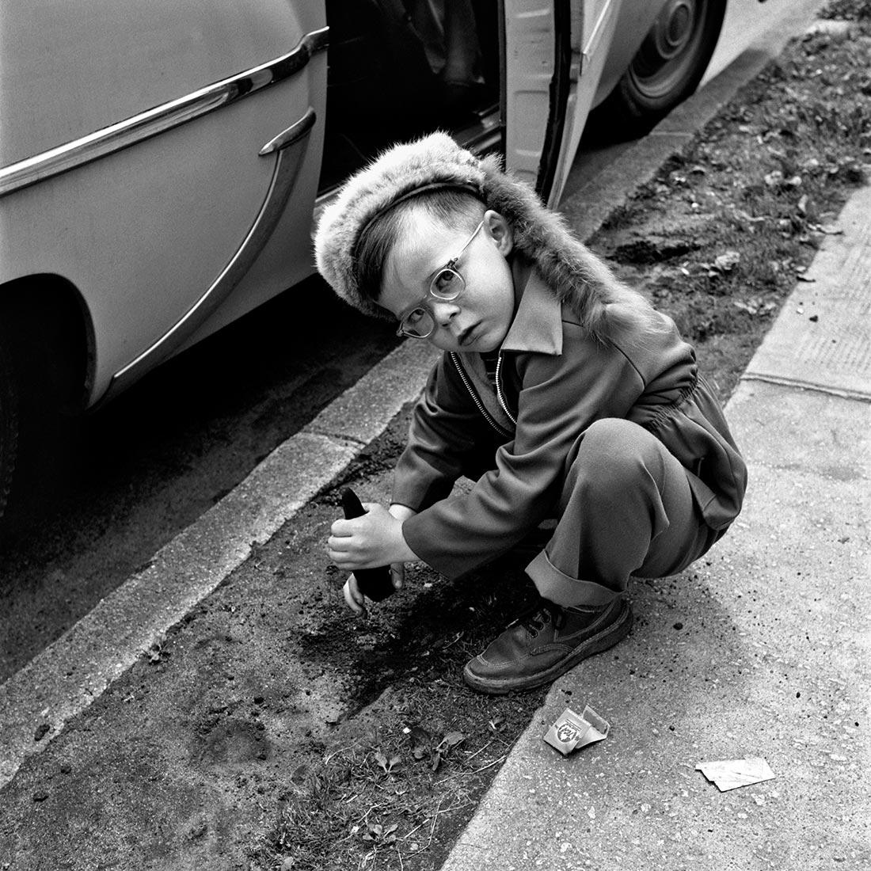

Slide 5
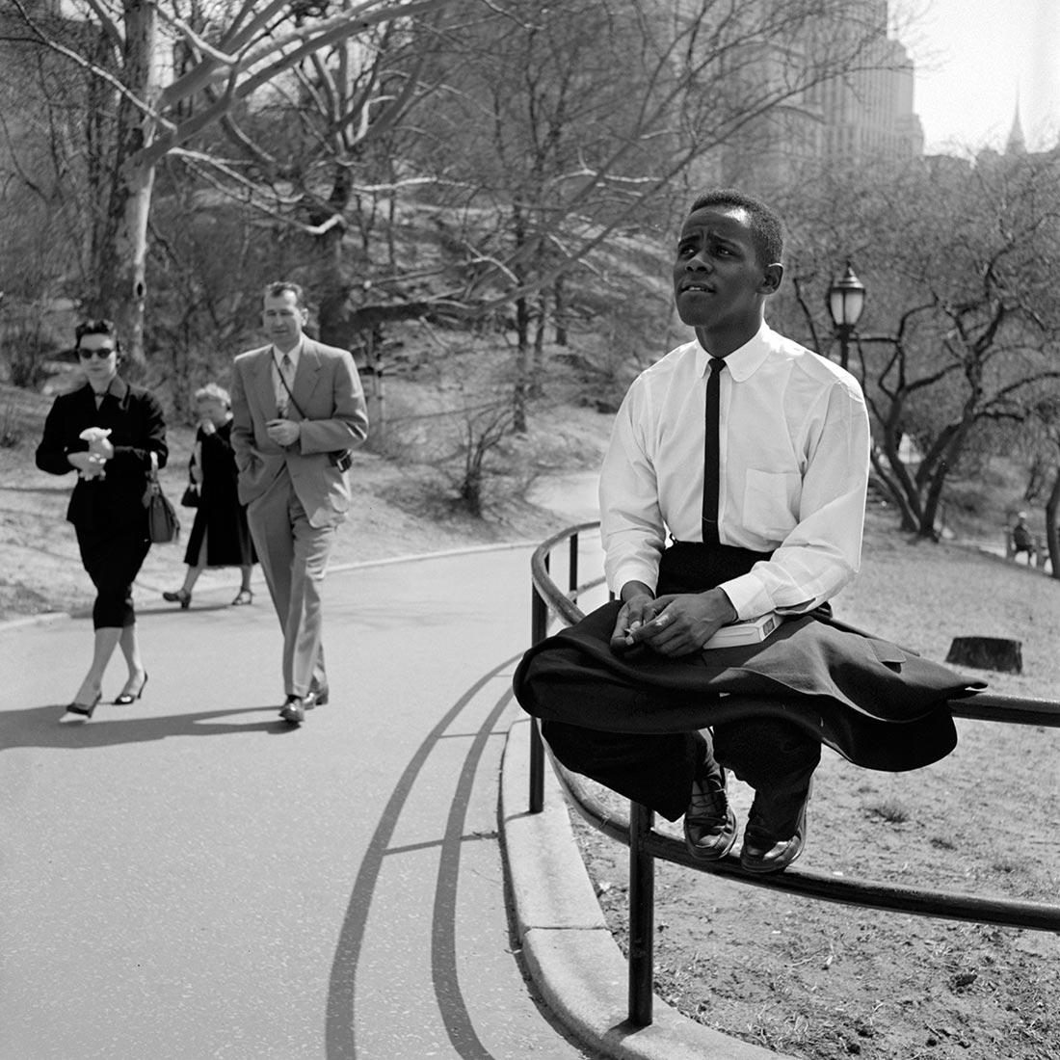

Slide 6
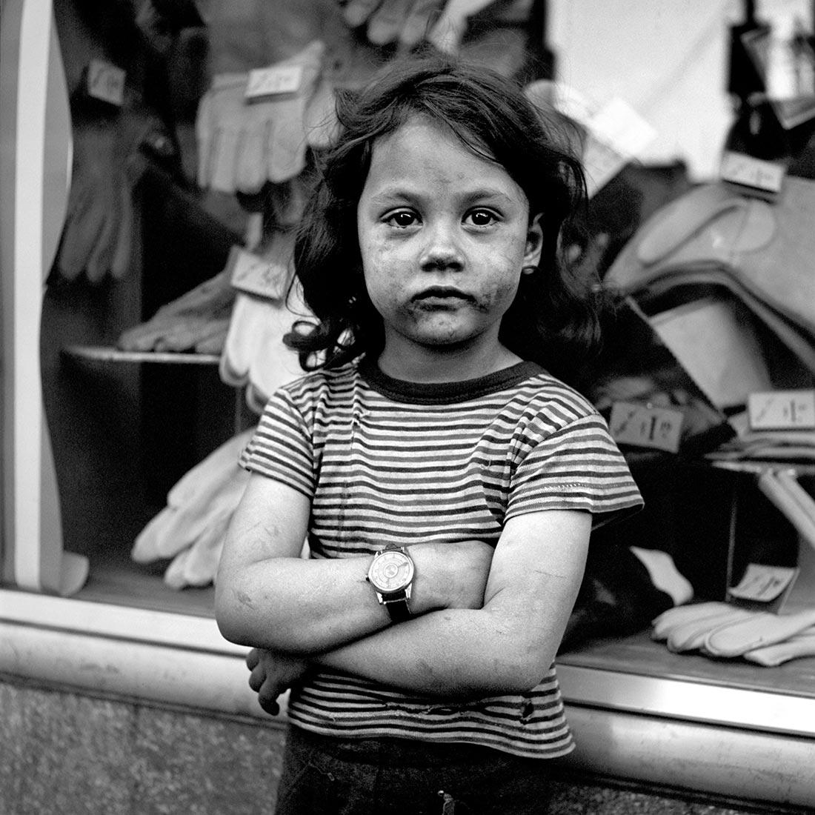

Slide 7
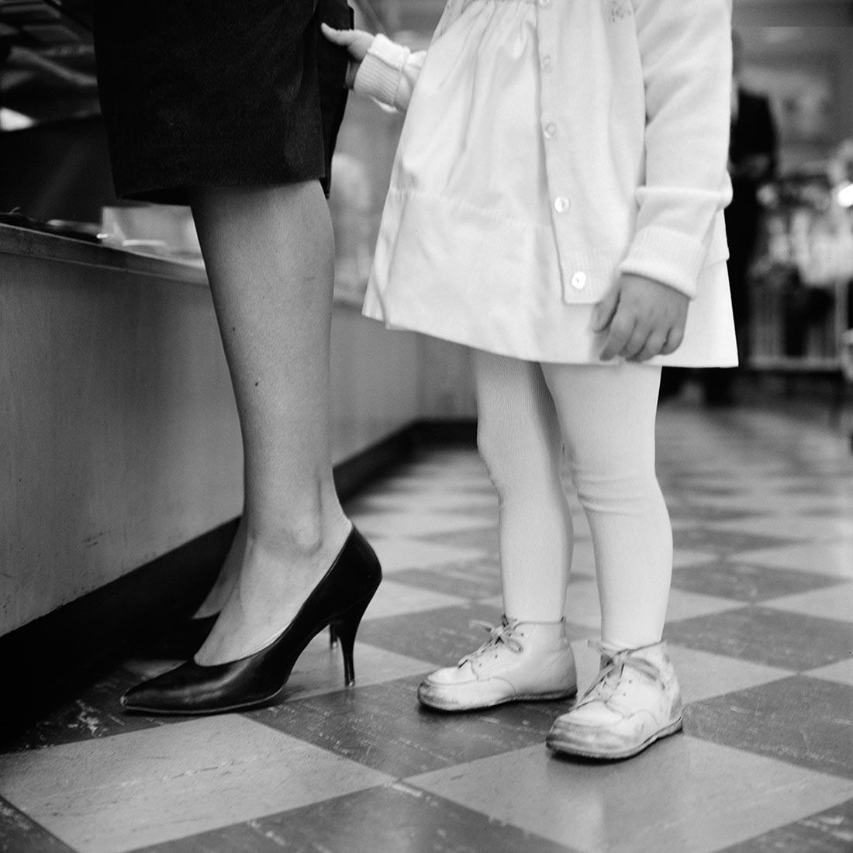

Slide 8
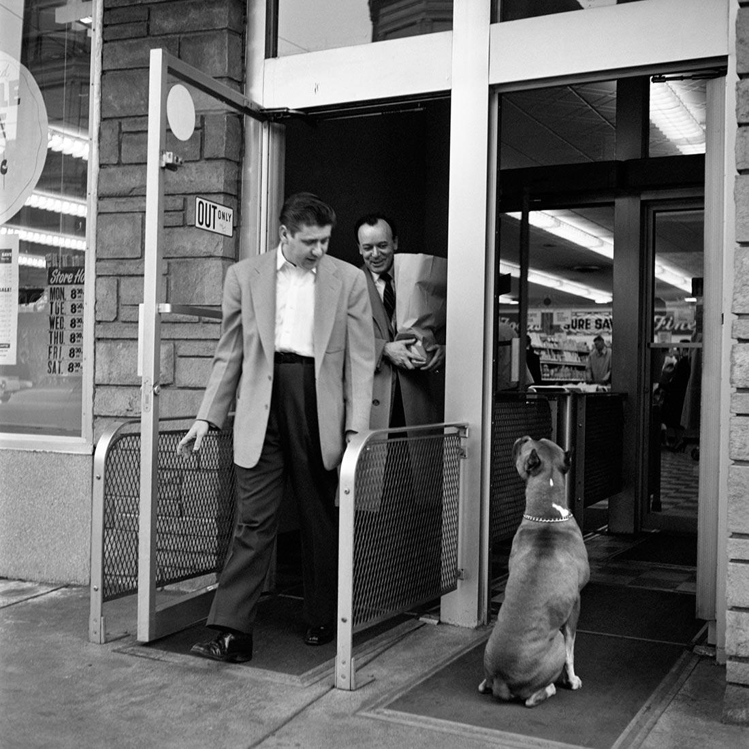

Slide 9
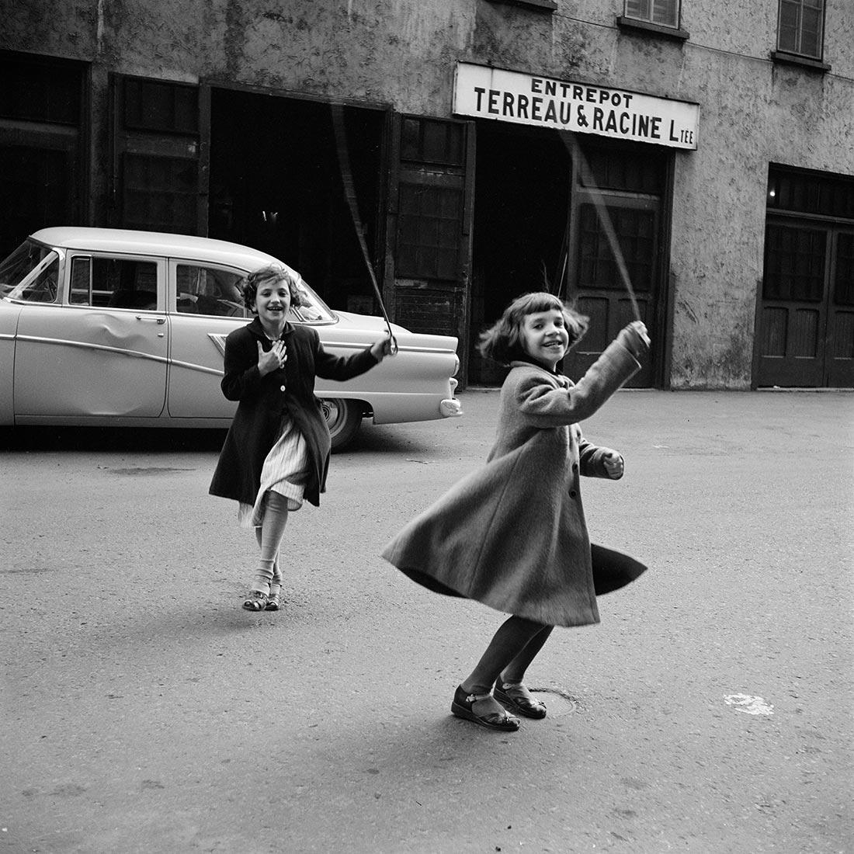

Slide 10
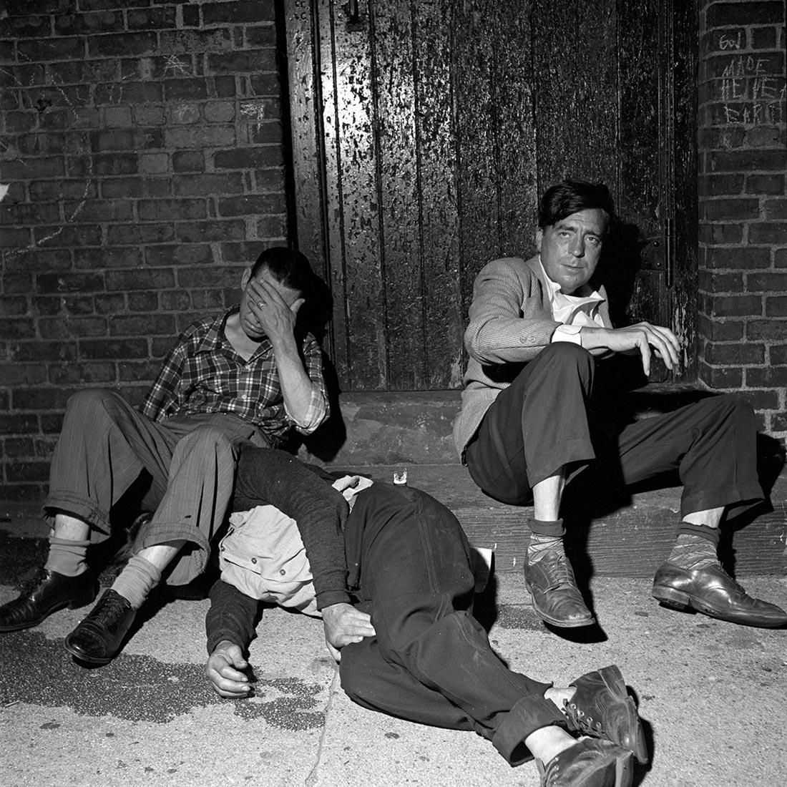

Slide 11
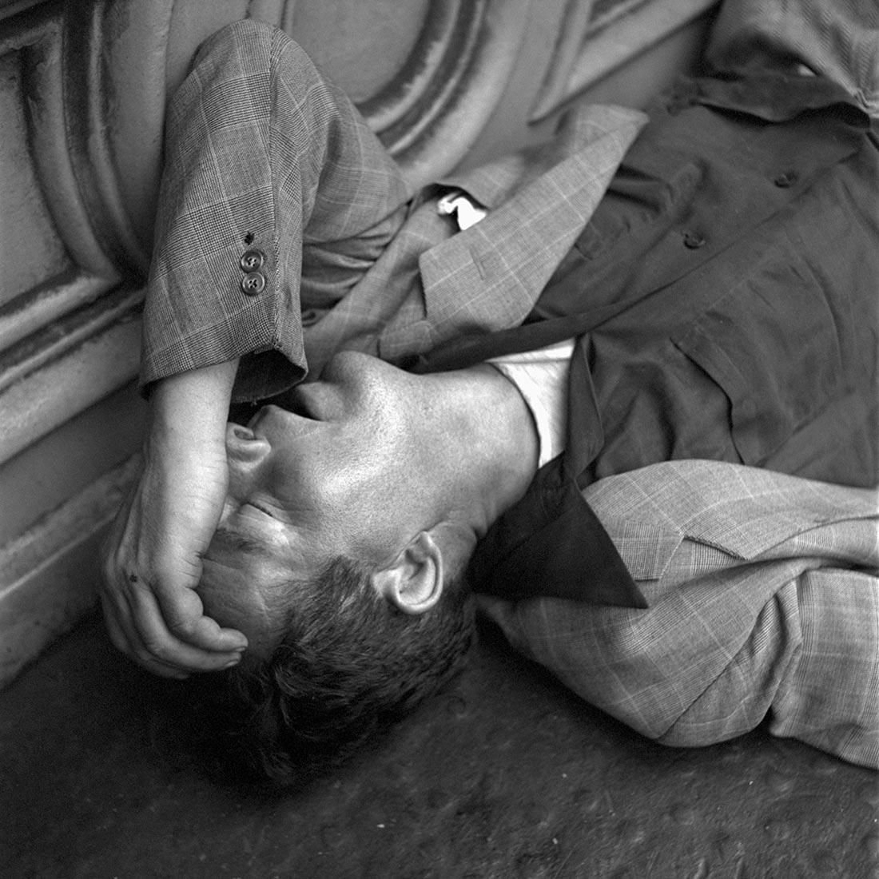

Slide 12
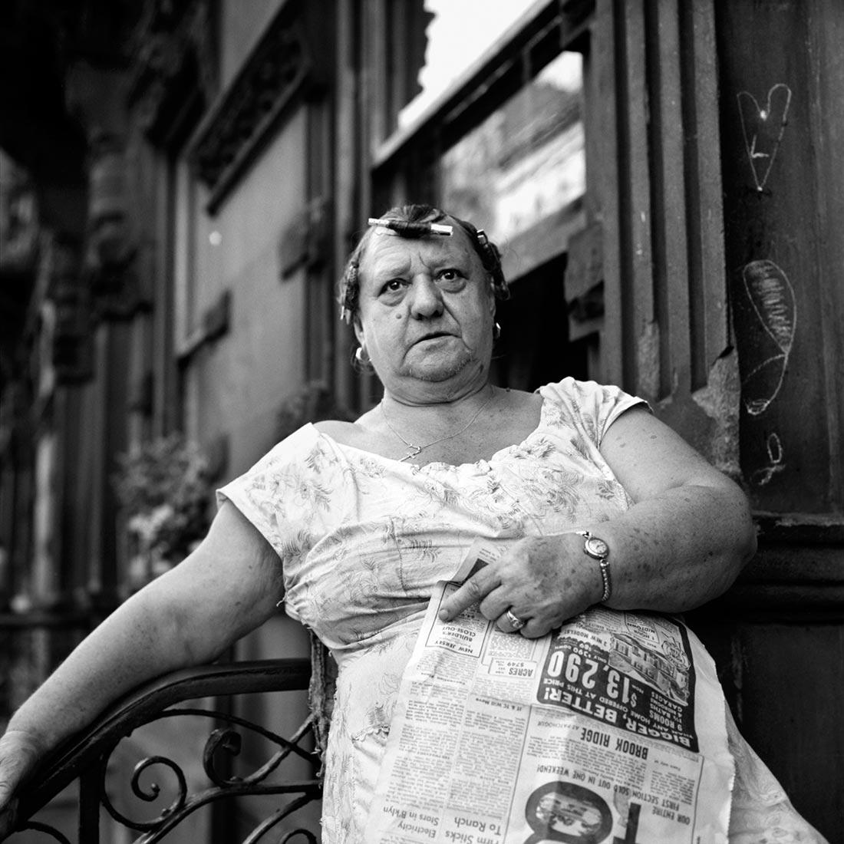

Slide 13
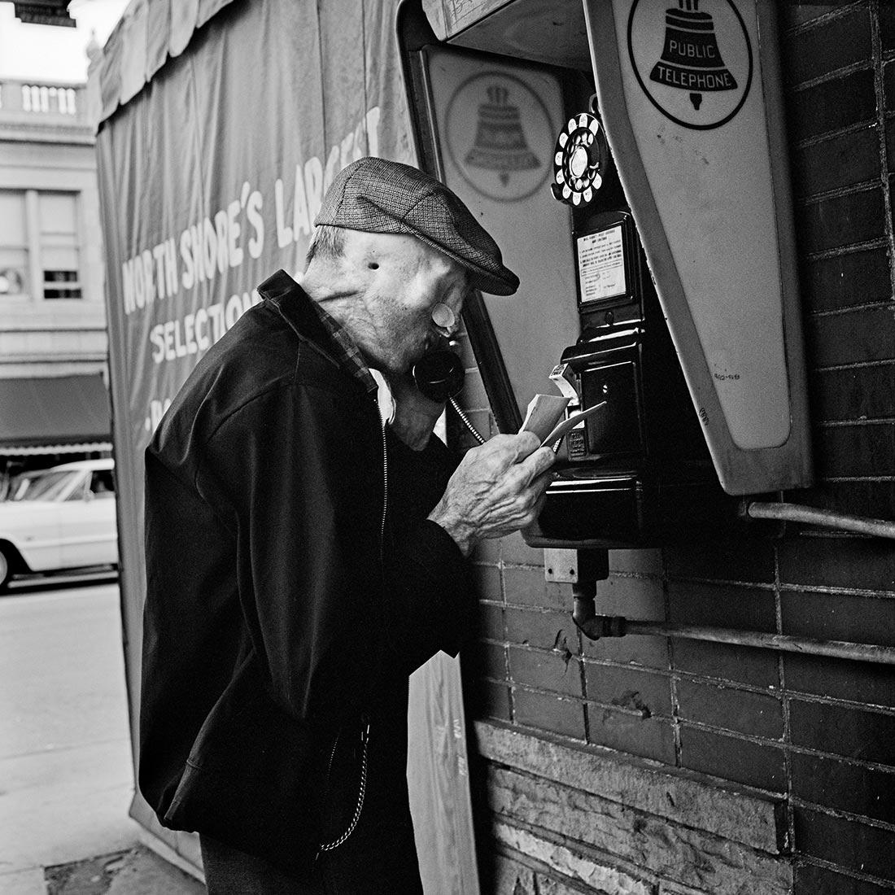

Slide 14
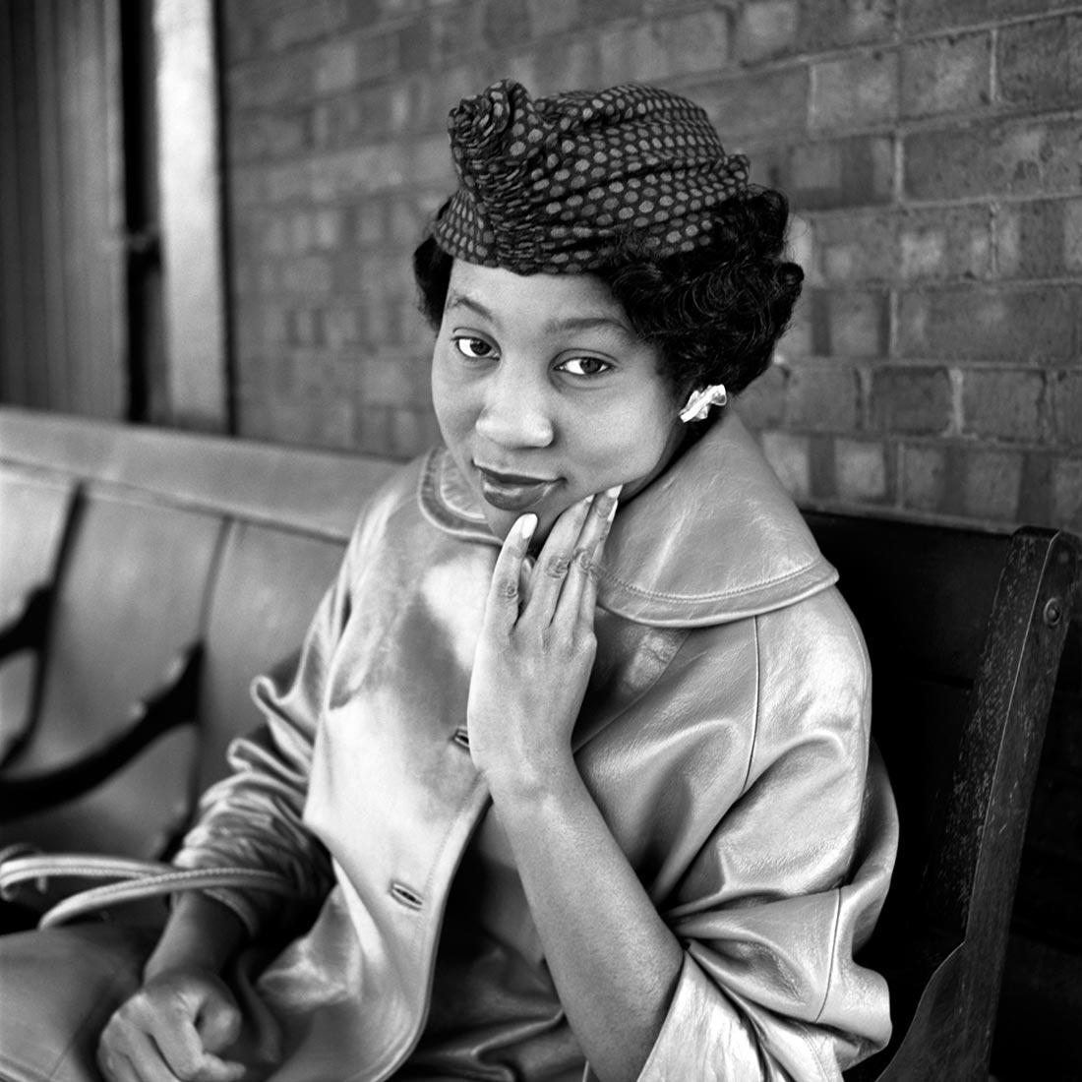

Slide 15
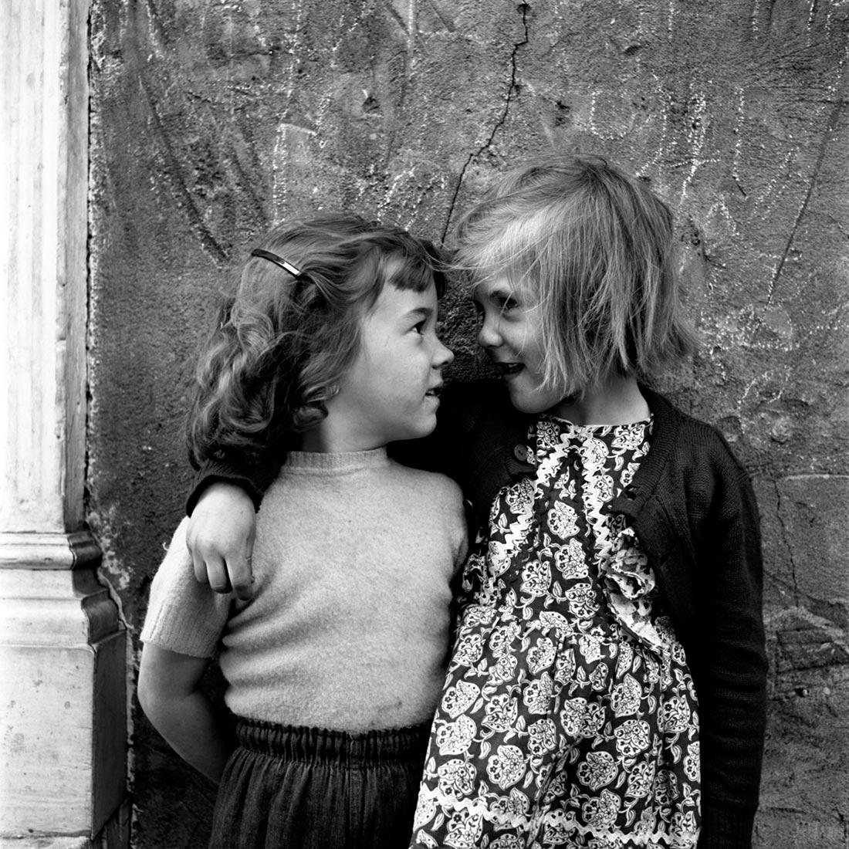

Slide 16
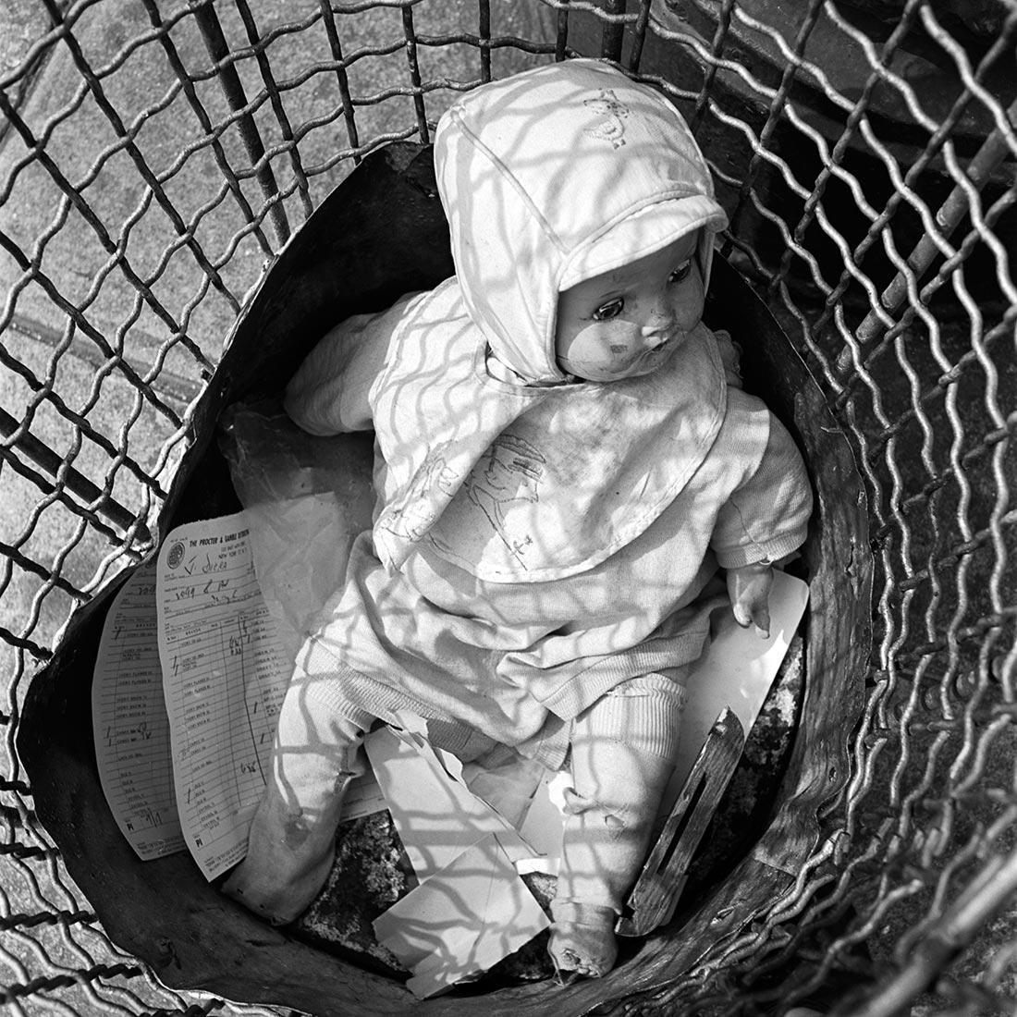

Slide 17
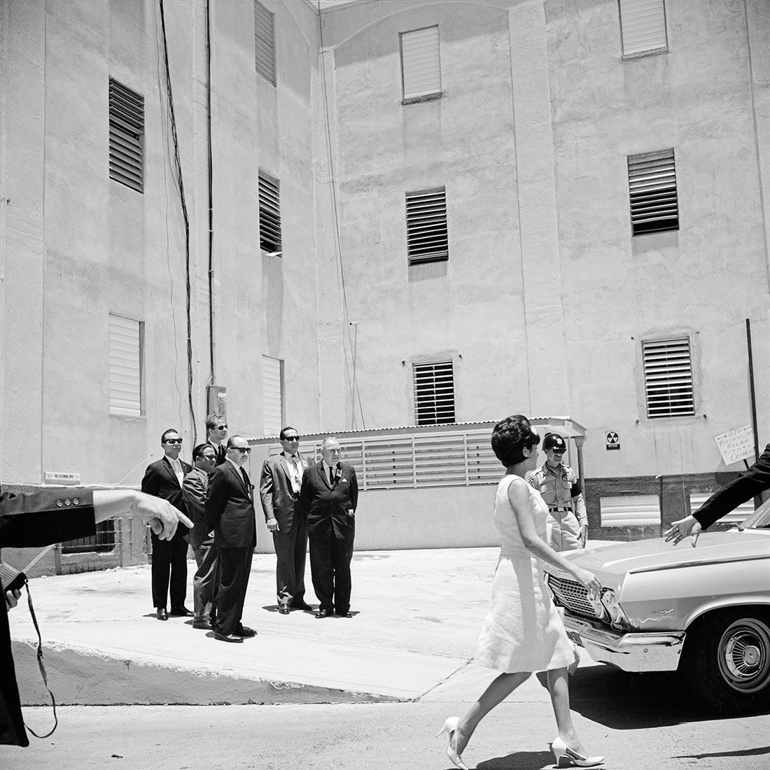

Slide 18
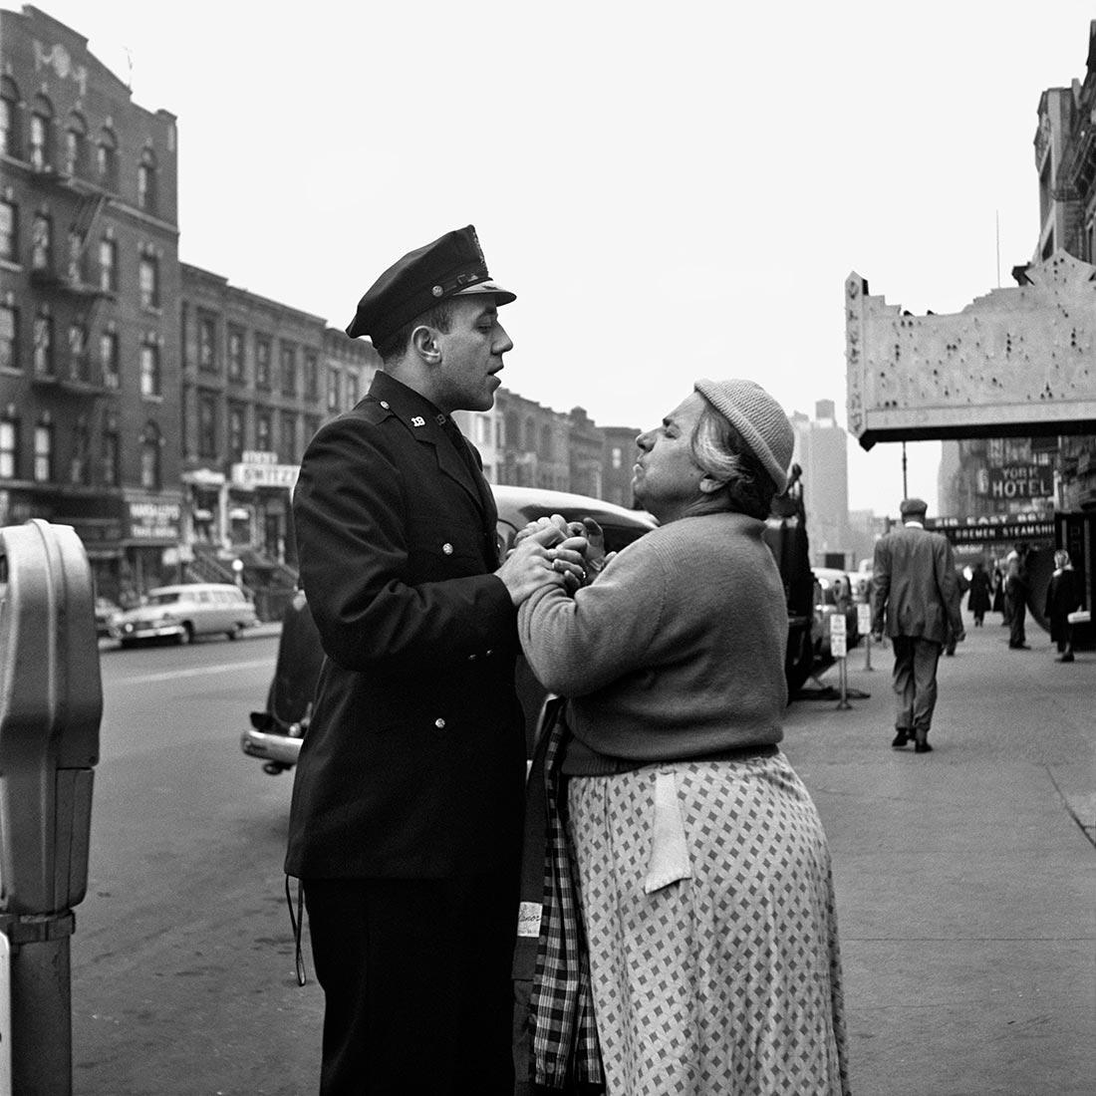

Slide 19
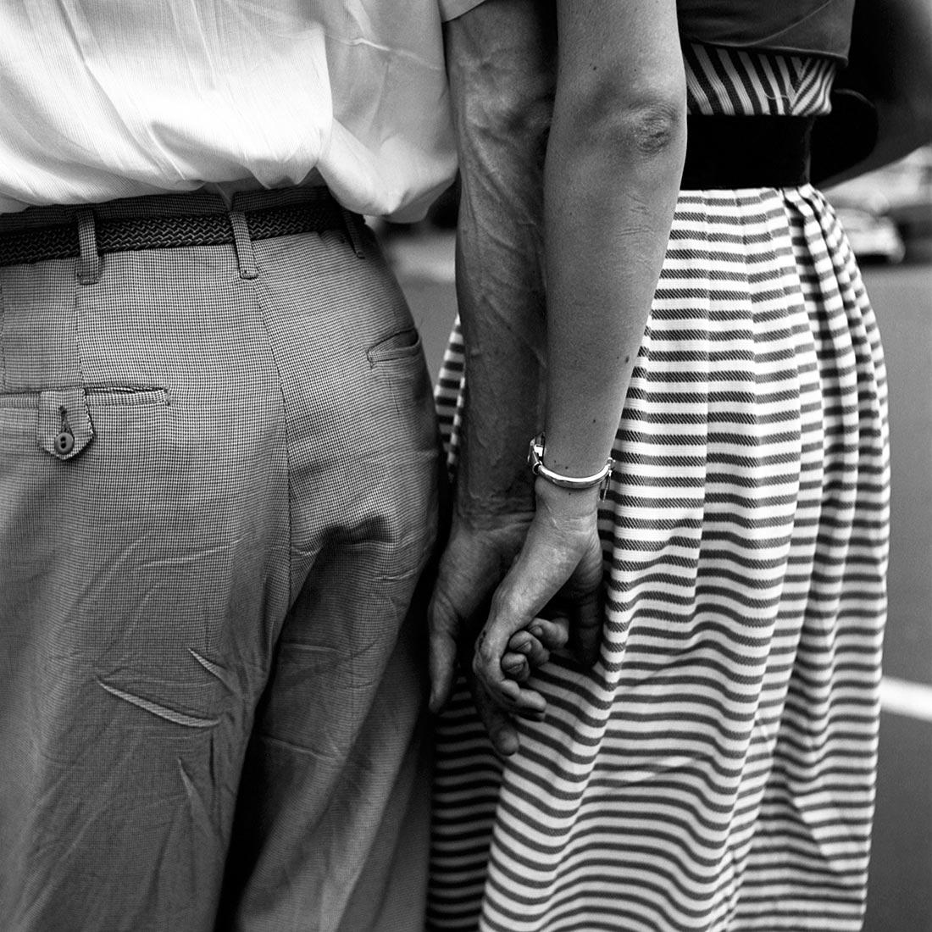

Slide 20
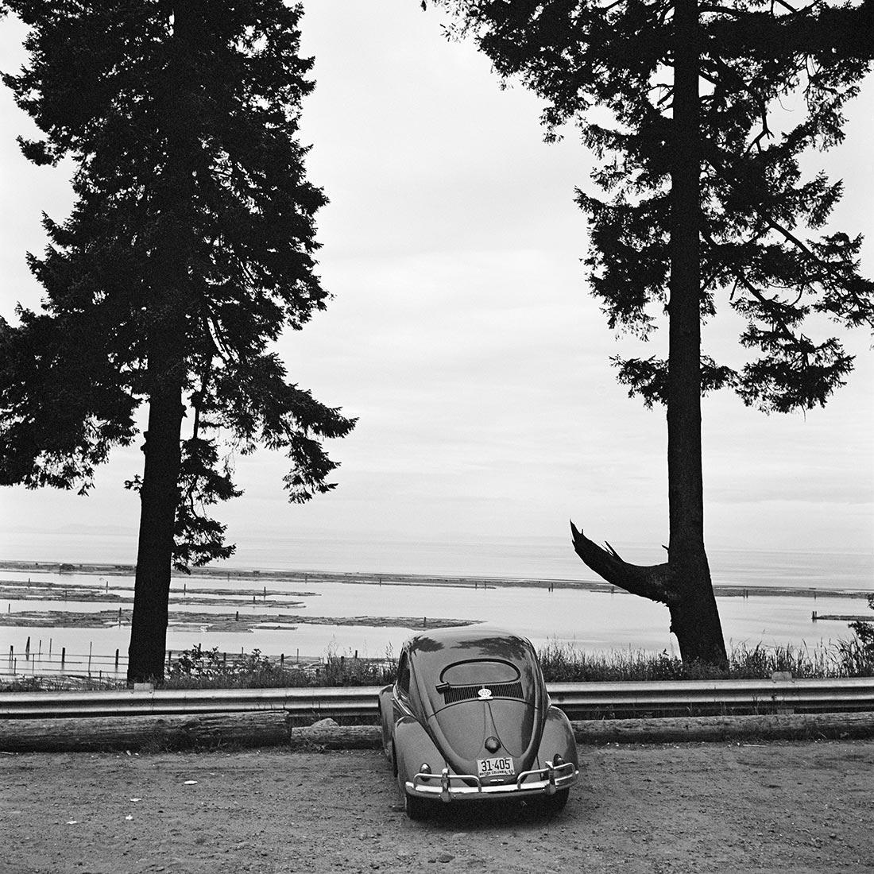

Slide 21
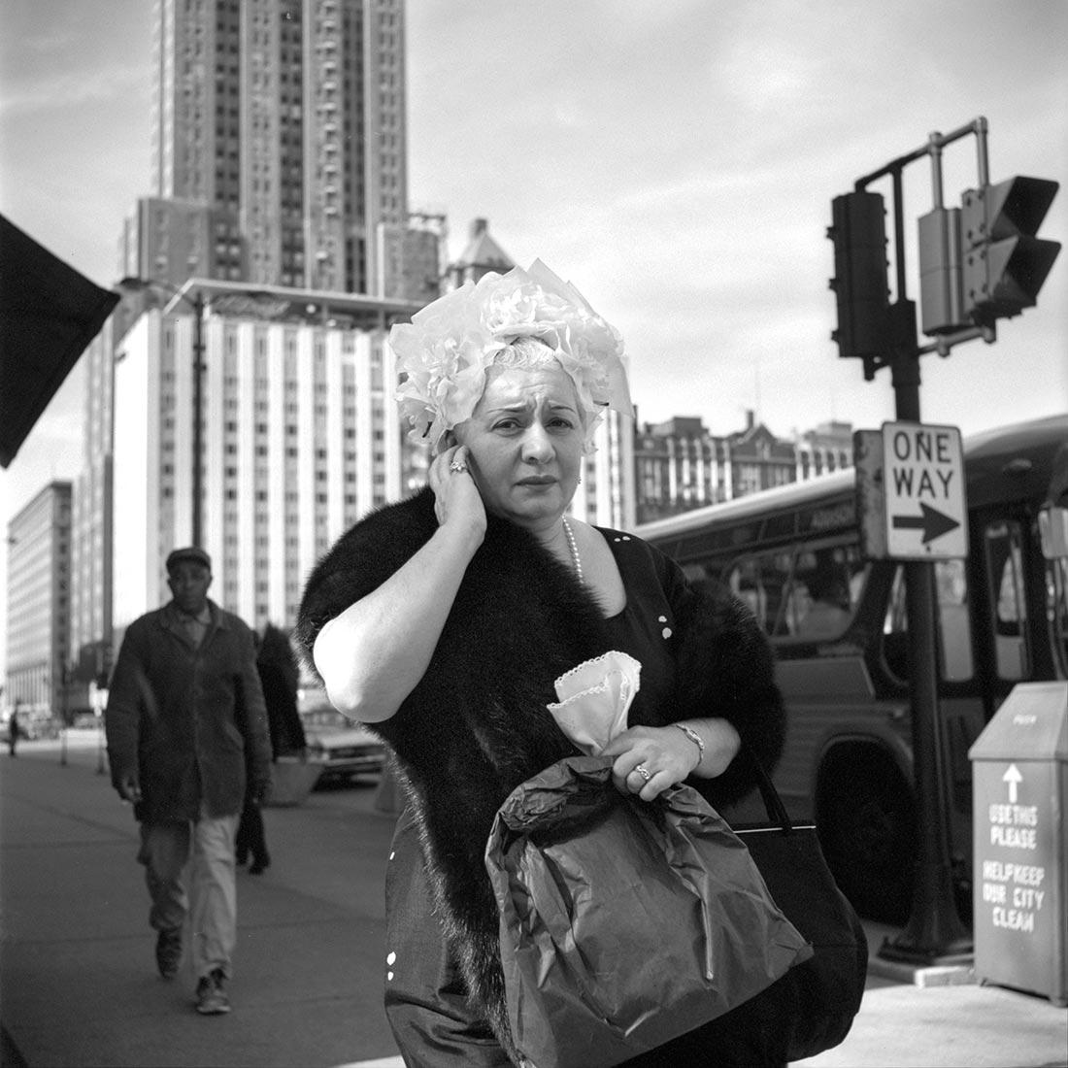

Slide 22
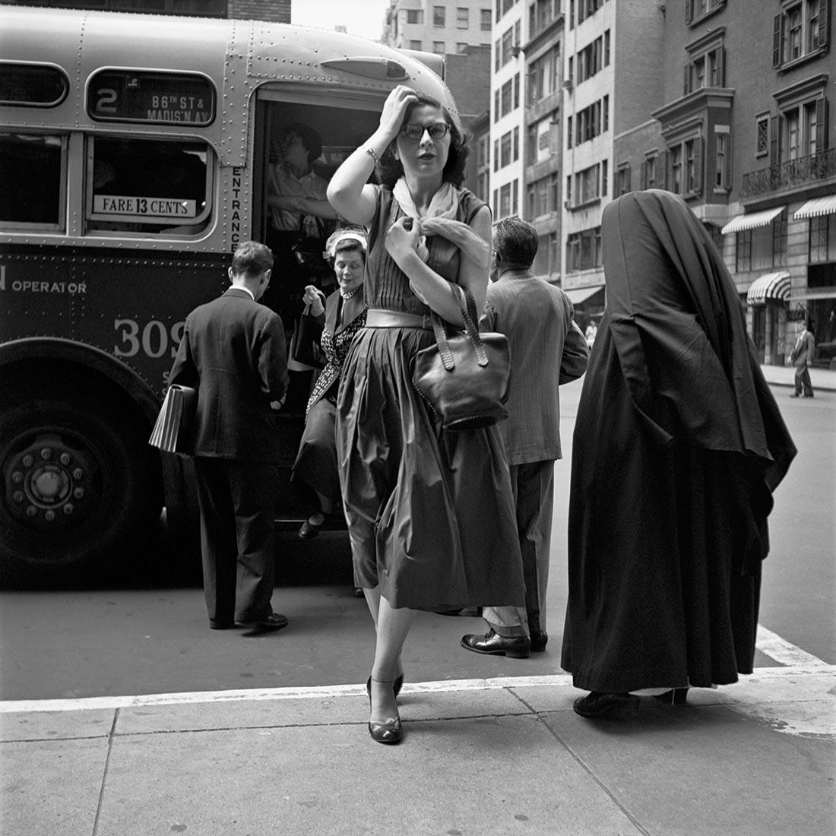

Slide 23
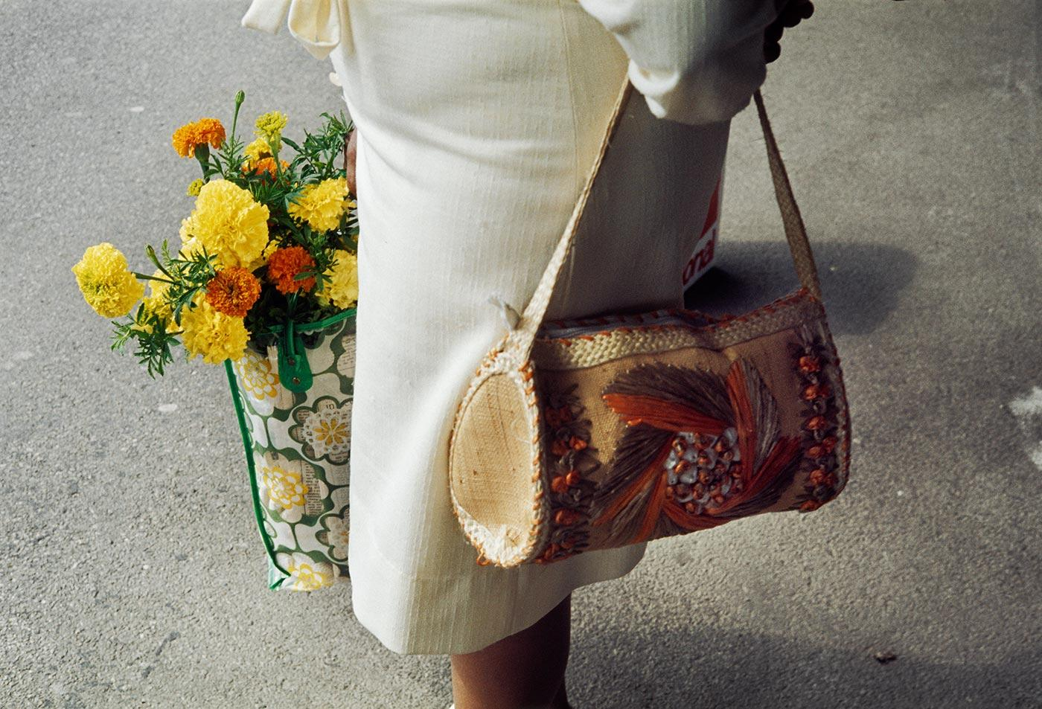

Slide 24
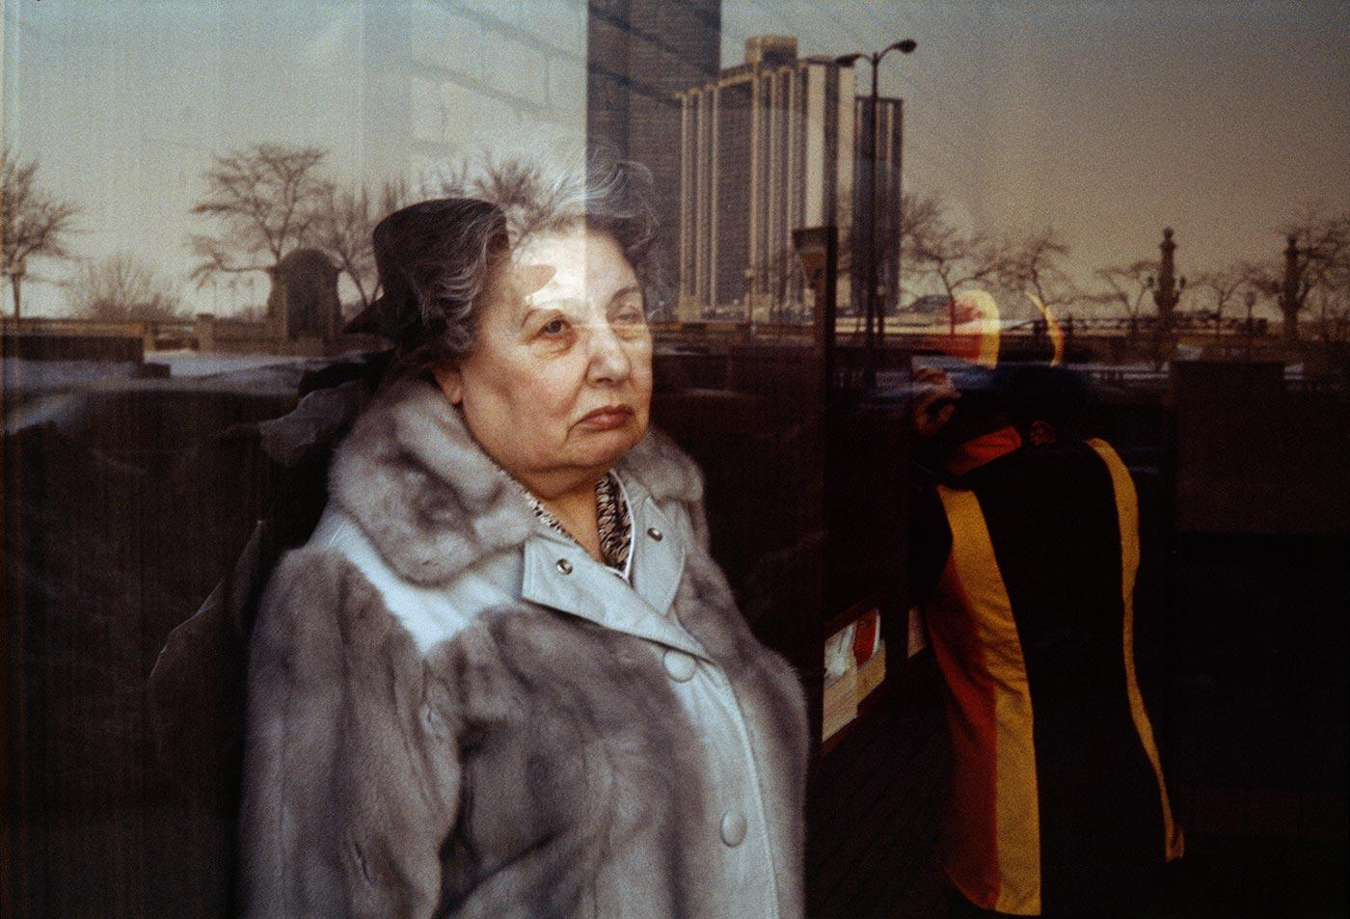

Slide 25
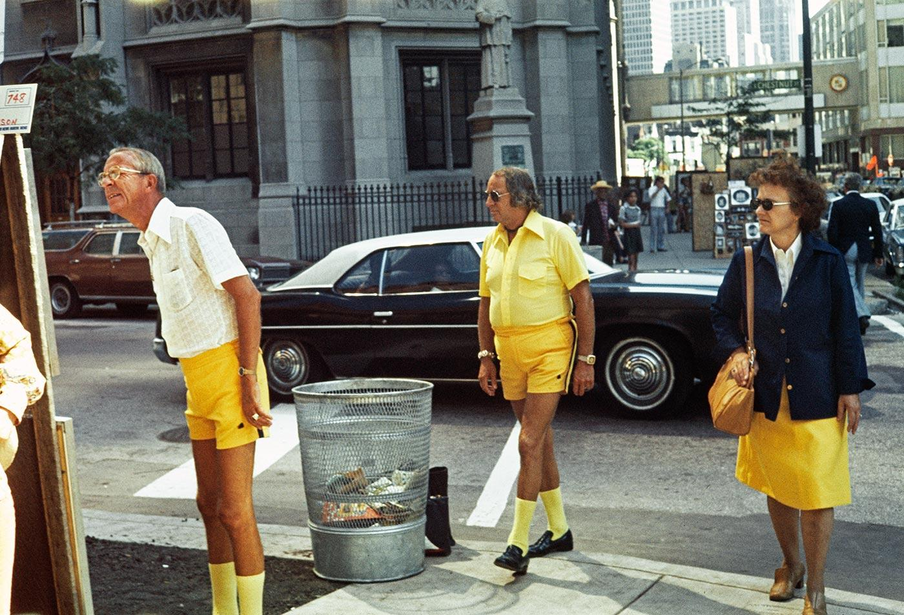

Slide 26
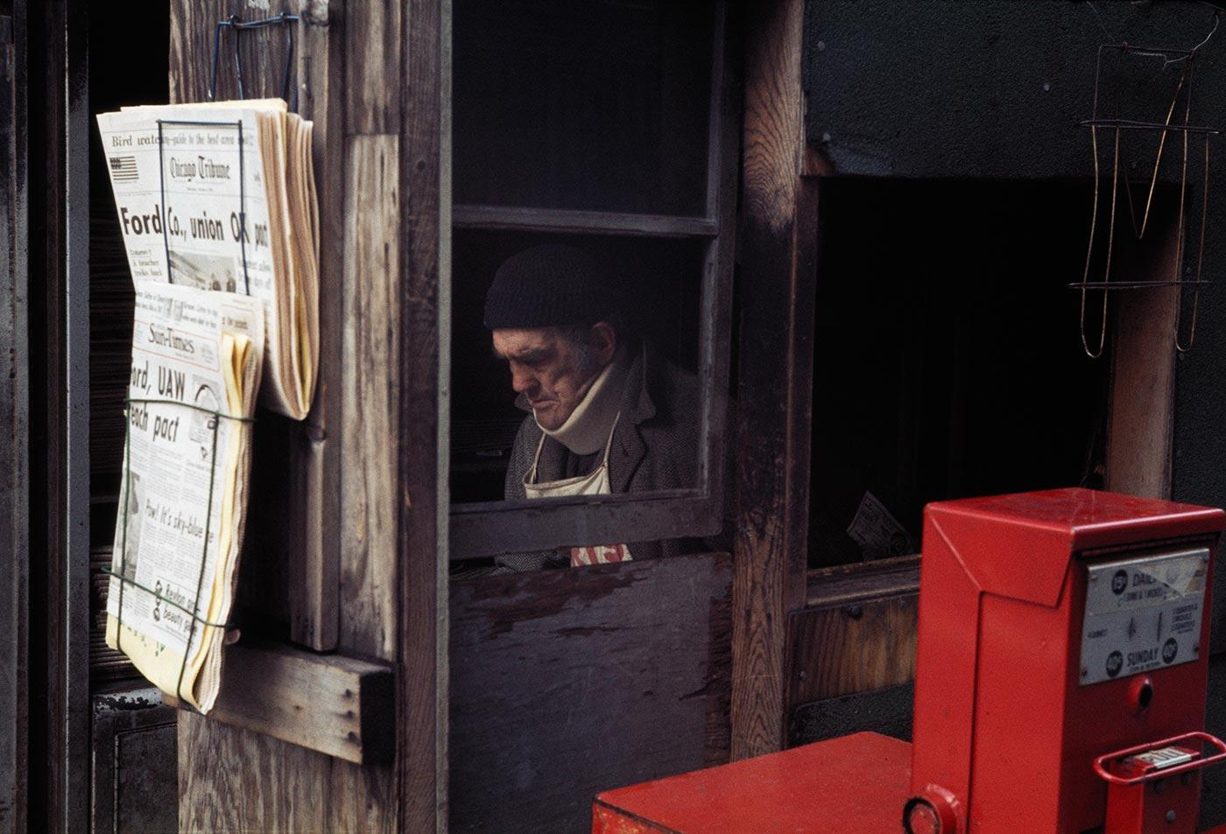

Slide 27
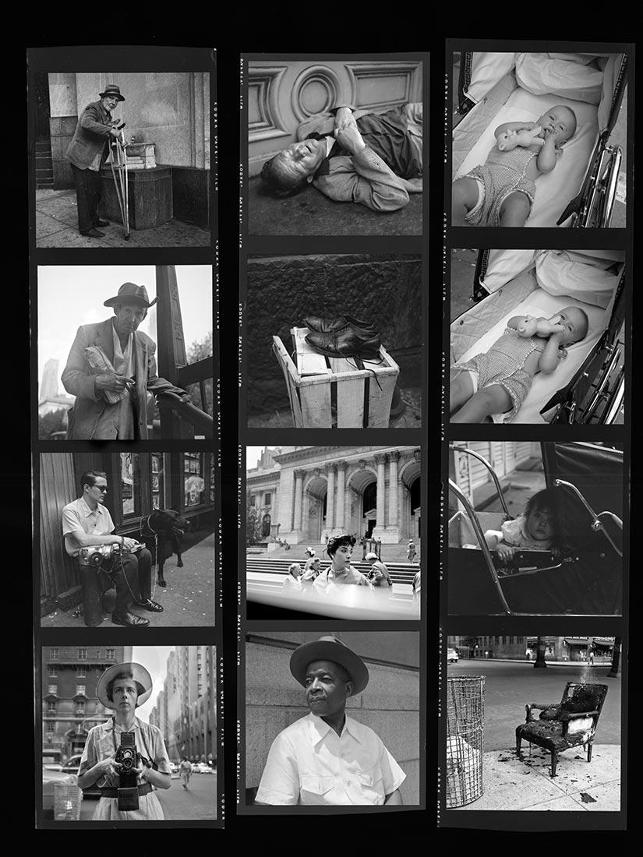

Slide 28
